Slide 1
Congratulations May 2020 Graduates
1
2

Slide 2
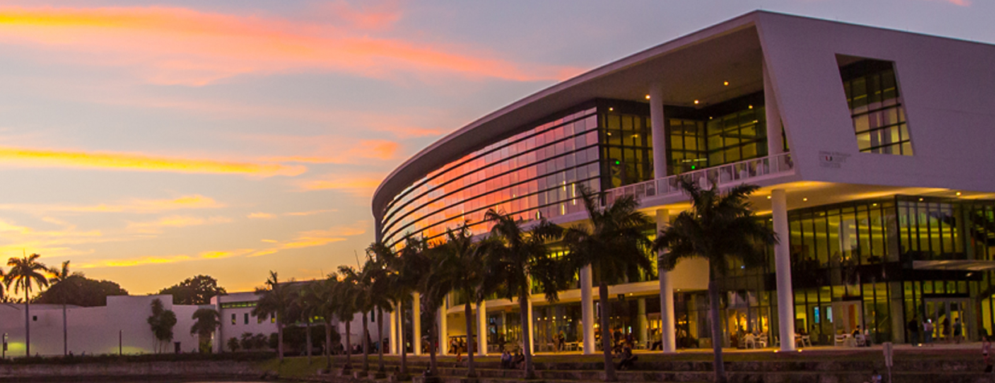
Dear Graduates,
The Center for the Humanities is pleased to offer this small tribute to the University of Miami class of 2020. Although we are unable to celebrate with you in person, physical distance will not prevent our celebrating you and your achievements at UM and beyond. From all over the globe, we at the university commend you for your hard work and congratulate you on this milestone. We hope you enjoy this collection of memories, quotes, photos, and messages from your classmates and instructors in the humanities.
- The Center for the Humanities
“When people talk about senior year of college being unforgettable, they aren’t usually talking about a pandemic. But I’ve been impressed by the resiliency and resourcefulness of all my students and especially the seniors in this very strange semester. It’s common knowledge (and generally true) that young adults are currently facing more challenges the previous couple of generations, and here we have a pandemic on top of everything else. The good news is that young people continue to handle these challenges surprisingly well.”
-Dr. Hugh Thomas, Professor of History &
Director, Center for the Humanities
1
2

Slide 3
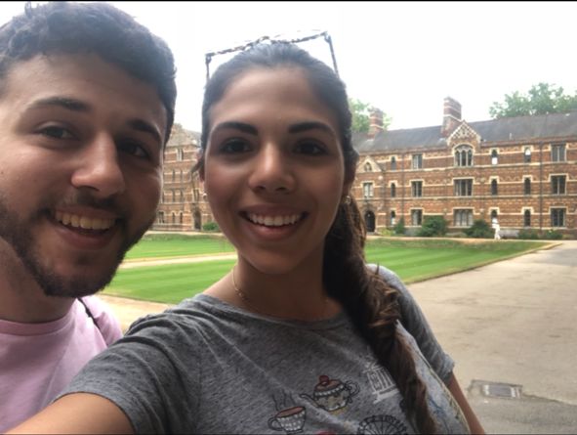
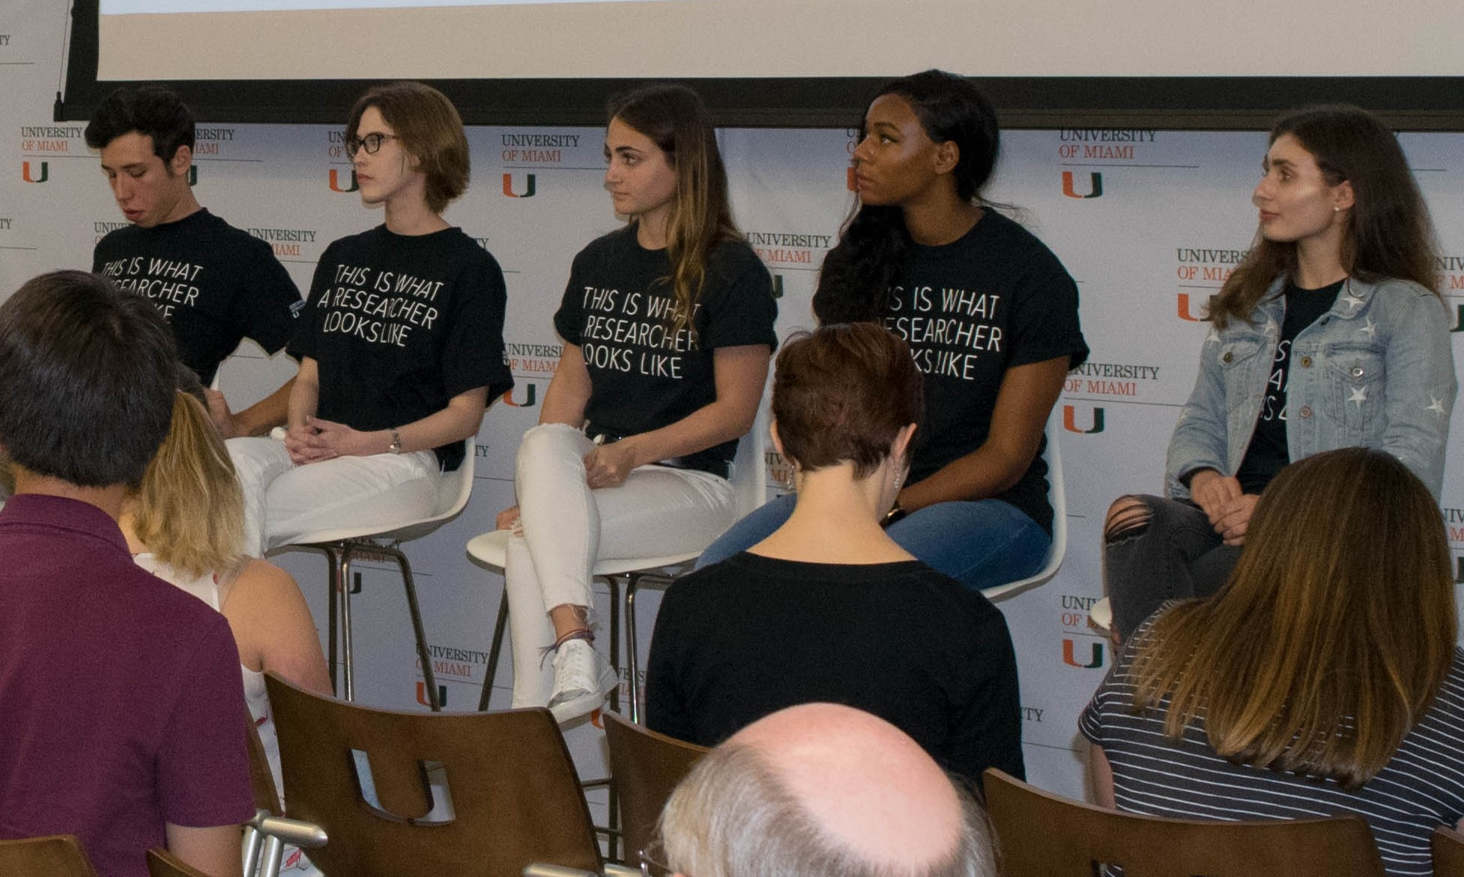
“She decided long ago that life was a long journey. She would be strong, and she would be weak, and both would be okay.”
- Furthermore
by Tahereh Mafi
“These are the times that try men’s souls." The greedy and the impatient “will, in this crisis, shrink from the service of their country; but he that stands by it now, deserves the love and thanks of man and woman." (Thank you Thomas Paine).
Congratulations to the U’s graduating seniors!
- Bonnie Smith Rigg, Art History
Avi Botwinick visiting Carolina Mallar while studying abroad at Oxford University
Dear Seniors,
Dr. Seuss was your first philosophy teacher; hopefully we philosophers here at UM won't be your last. Let's send you on your way with some soothing examples of
Seuss-y wisdom:
"Oh, the thinks you can think!”
"Think left and think right and think low and think high. Oh, the thinks you can think if only you try!”
“Today you are you, that is truer than true. There is no one alive who is youer than you.”
"And will you succeed? Yes you will indeed! (98 and 3/4 percent guaranteed.)”
—Brit Brogaard, (Dr. Seuss) Professor of Philosophy
Seniors Alyssa Samberg (center) and Daniela Baboun (far right) join their peers on a student researcher panel at the 2019 Inquiring Minds event, sharing their experiences in humanities research
3
4

Slide 4
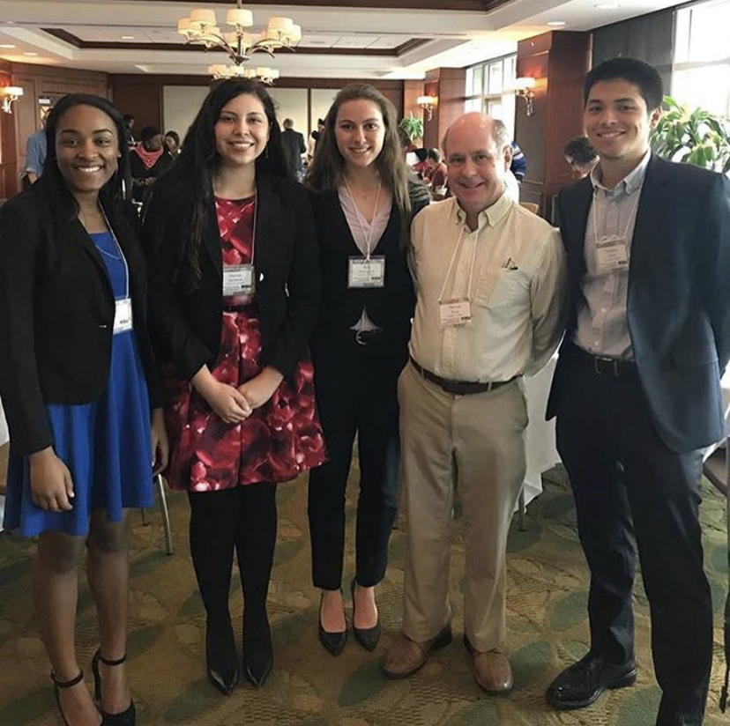
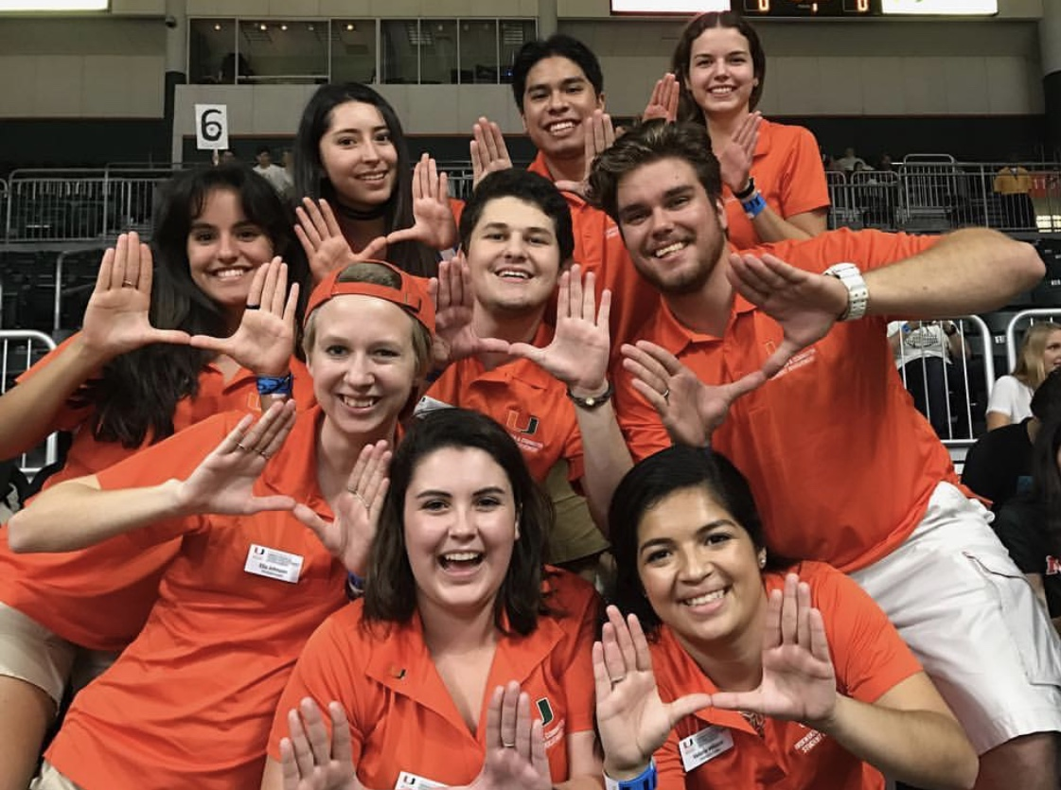
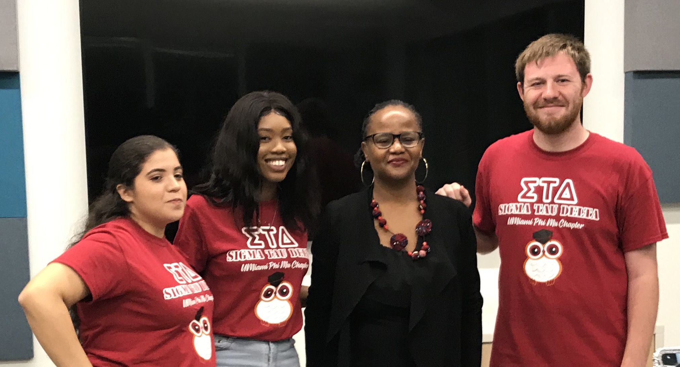
Hope is the thing with feathers -
That perches in the soul -
And sings the tune without the words -
And never stops - at all -
And sweetest - in the Gale - is heard -
And sore must be the storm -
That could abash the little Bird
That kept so many warm -
I’ve heard it in the chillest land -
And on the strangest Sea -
Yet - never - in Extremity,
It asked a crumb - of me.
-Emily Dickinson
“You may be getting tired of hearing things like ‘in these trying/challenging/unprecedented times…’ followed by some genuine words of solidarity (or perhaps an attempt to sell you some stuff). Yes, these are difficult times, but you’ve known difficulty before. And you persisted. After all, the difficult times are not the entirety of your experiences as a student, as a person, as a citizen. These past few months do not define or diminish all that you’ve done. You’ve had revelations, you’ve conquered obstacles, you’ve loved, you’ve been humbled, you’ve rejoiced, and you have grown. My wish for you is that you look back on your time at this place and find yourself swimming in those memories, even the tough ones, revitalized by the experiences that shaped who you are and who you are becoming.”
- Dr. Meg Homer, Assistant Director, Center for the Humanities
We are ‘Canes, the ibis is our mascot and our symbol—the thing with feathers, beautiful and strong during storms, resilient and community-oriented. The class of 2020 is made up of ‘Canes like that—I don’t have any doubt about it.
-Prof Maria Stampino
Sigma Tau Delta seniors (from left) Nathalie Mairena, Chinoia Weir, and William Stickle (far right) pose with spring 2020 One Book, One U author Edwidge Danticat after “American Alien: A Discussion with Edwidge Danticat.”
5
6

Slide 5
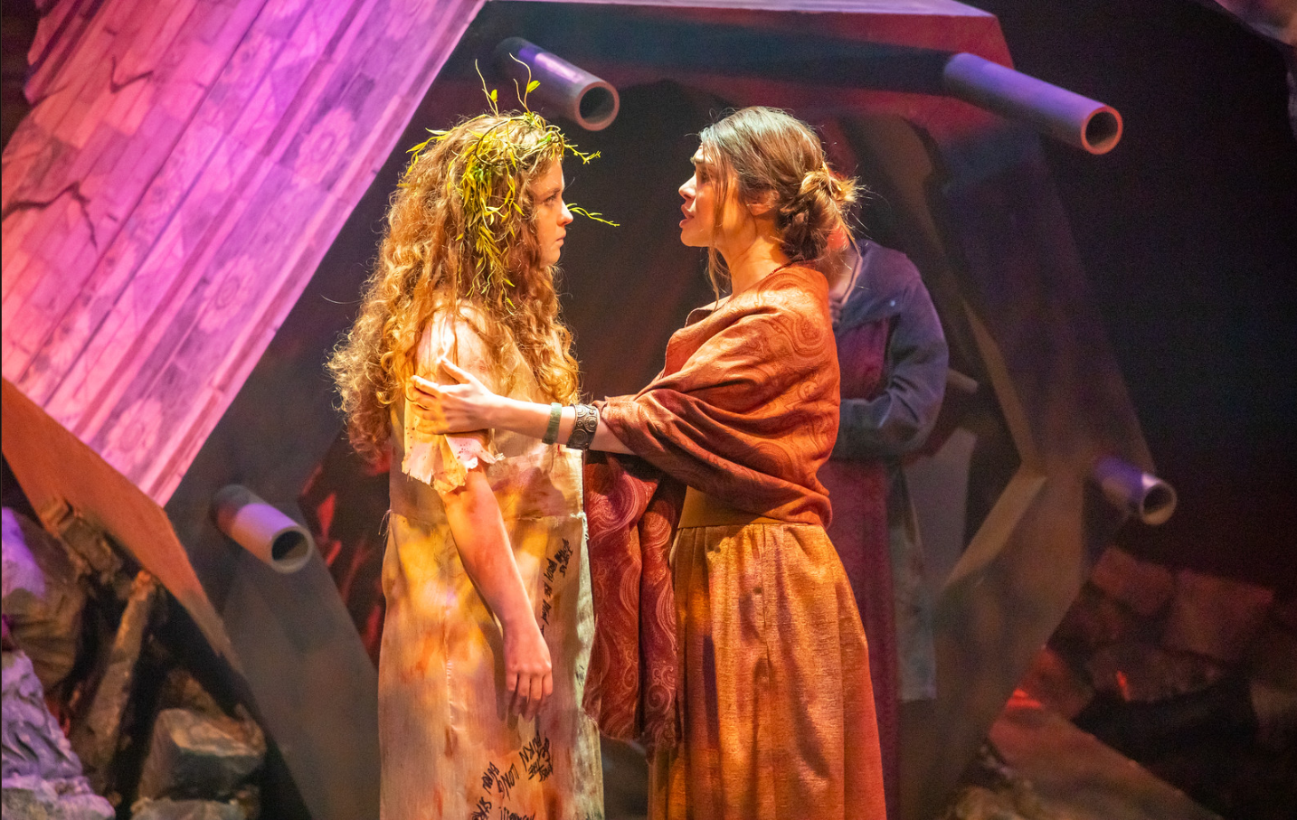
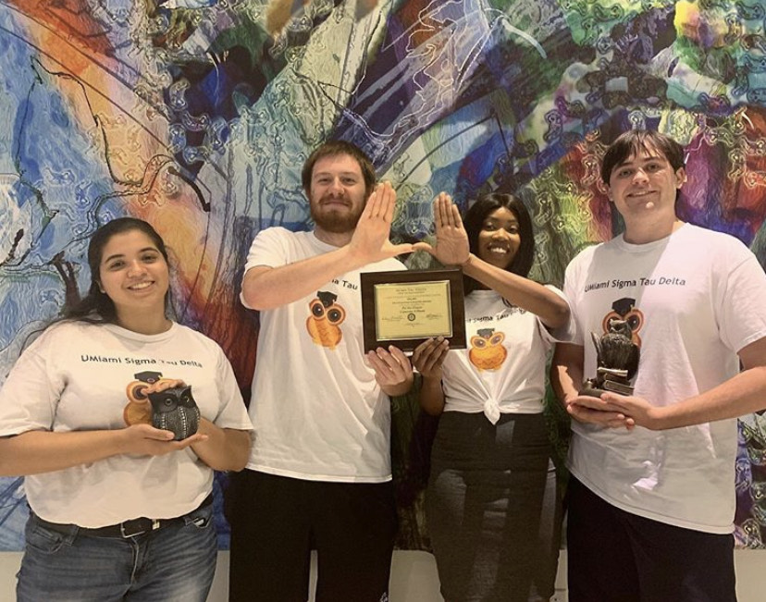
From Dr. John Paul Russo, Professor of Classics
“Life is not short; we make it short,” wrote the Latin writer Seneca. That is, we squander our time: “Life is sufficiently long, and has been granted with enough generosity for us to accomplish the greatest things, provided that in its entirety it is well invested.”
- On the Shortness of Life (trans. J. Davie)
Sophia Leicht and classmate Dayana Corton performing the roles of Cassandra and Hecuba respectively in the Jerry Herman Ring Theatre’s production of The Trojan Women by Ellen McLaughlin from this February"
In 1593, the “Black Death” bubonic plague killed over 15,000 people and the theaters closed in Elizabethan London.
In 1603 plague struck again, killing over 30,000 people. It hit again in 1608.
Theater did not die.
During these years, Shakespeare wrote many of his great masterworks including King Lear, The Winter’s Tale, The Tempest, Hamlet, A Midsummer Night’s Dream, Twelfth Night, and Cymbeline, to name a few of his brilliant tragedies & comedies.
This is not the end. You will persevere. The best is still ahead! Hang in there, class of 2020!
Congratulations & best wishes,
Dr. Darren Blaney, Lecturer of Theatre Arts
Sigma Tau Delta executive board members accept the Outstanding Chapter Award in recognition of their achievement and service in celebrating the English language. Photographed from left to right are: Nathalie Mairena (Senior), William Stickle (Senior), Chinoia Weir (Senior) and Brice Sewell (Junior).
7
8

Slide 6
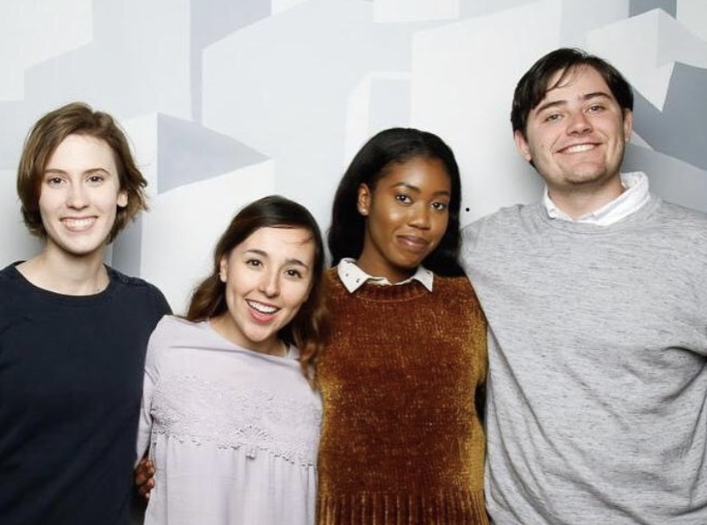
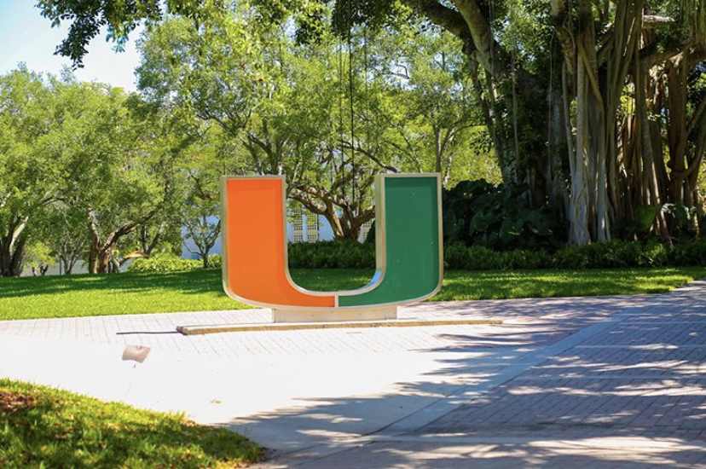
To my graduating seniors: You already know how heartbroken I am that we cannot end our semester together in the same room. Nevertheless, I want to send them huge CONGRATULATIONS, and to remind you that what you have learned together with your fellow writers here at UM has enormous value. For without stories, life quickly become chaotic. We never know who needs the story we have to tell, who will find in it meaning, or hope, or sense of purpose. And let us also remember the lesson from Amor Towles'Count Rostov, in his "...essential faith that by the smallest of one's actions one can restore some sense of order to the world..."
- Martha Otis
Whether your next step is grad school, a job, or a gap year, here are two inspiring quotations from my favorite writer about having the courage and passion to pursue what matters to you:
“What is now proved was once only imagined.” William Blake, Auguries of Innocence
“I cared not for consequences but wrote.” William Blake, Marriage of Heaven and Hell
- Kathryn Freeman
“Hoping for the best, prepared for the worst,
and unsurprised by anything in between.”
–I Know Why the Caged Bird Sings
by Maya Angelou
9
10

Slide 7
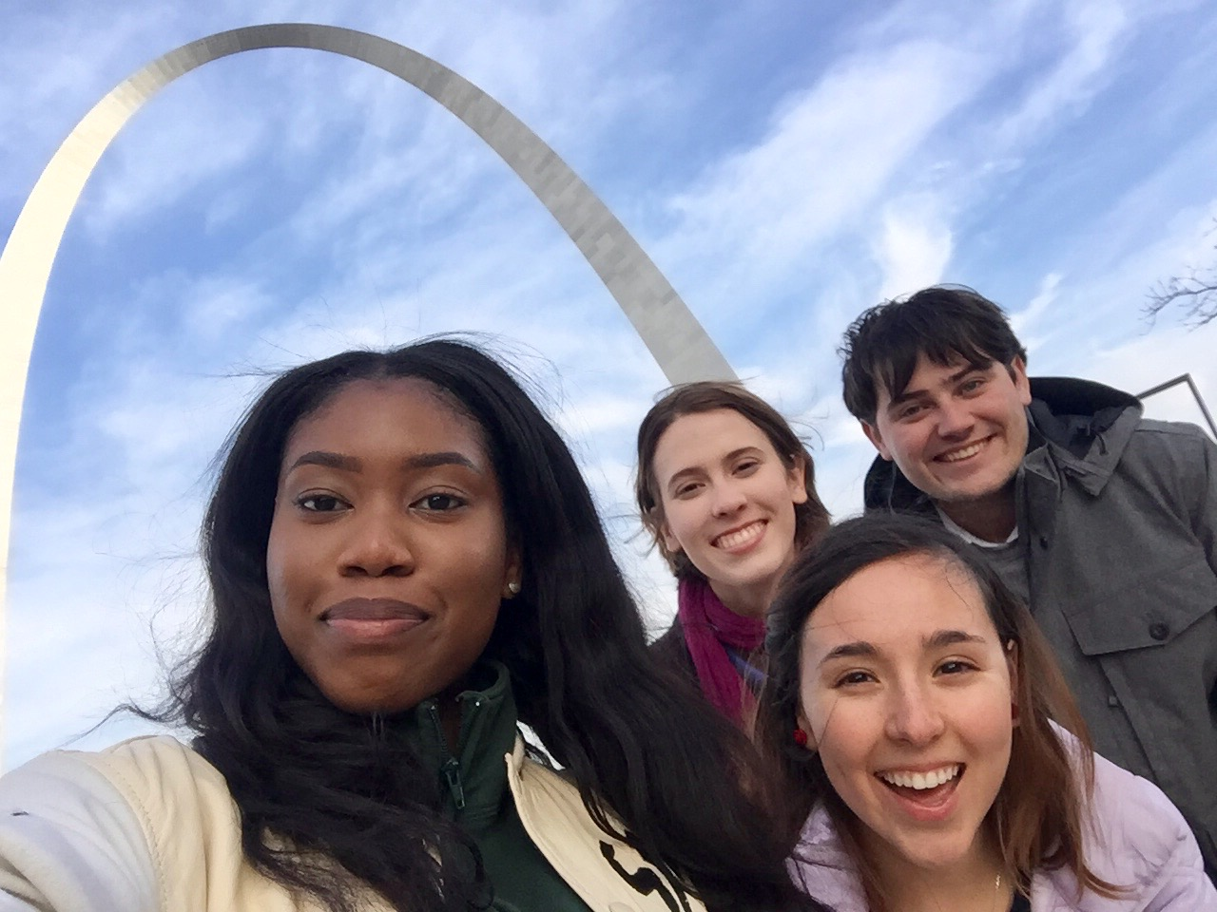
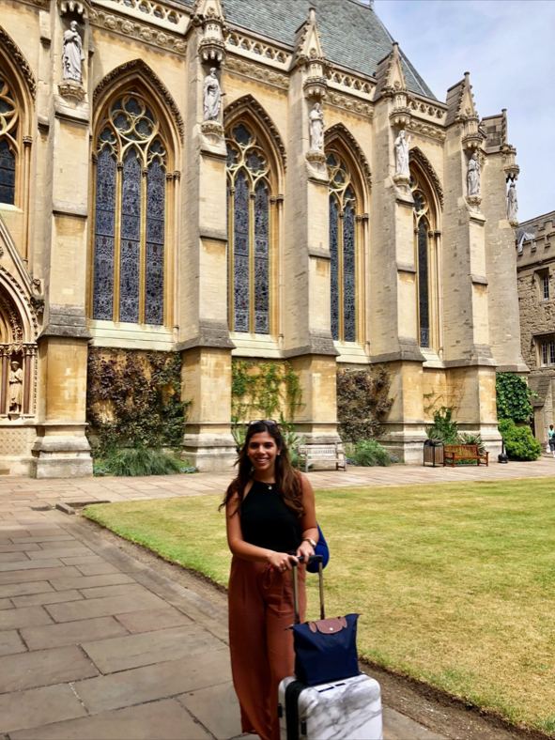
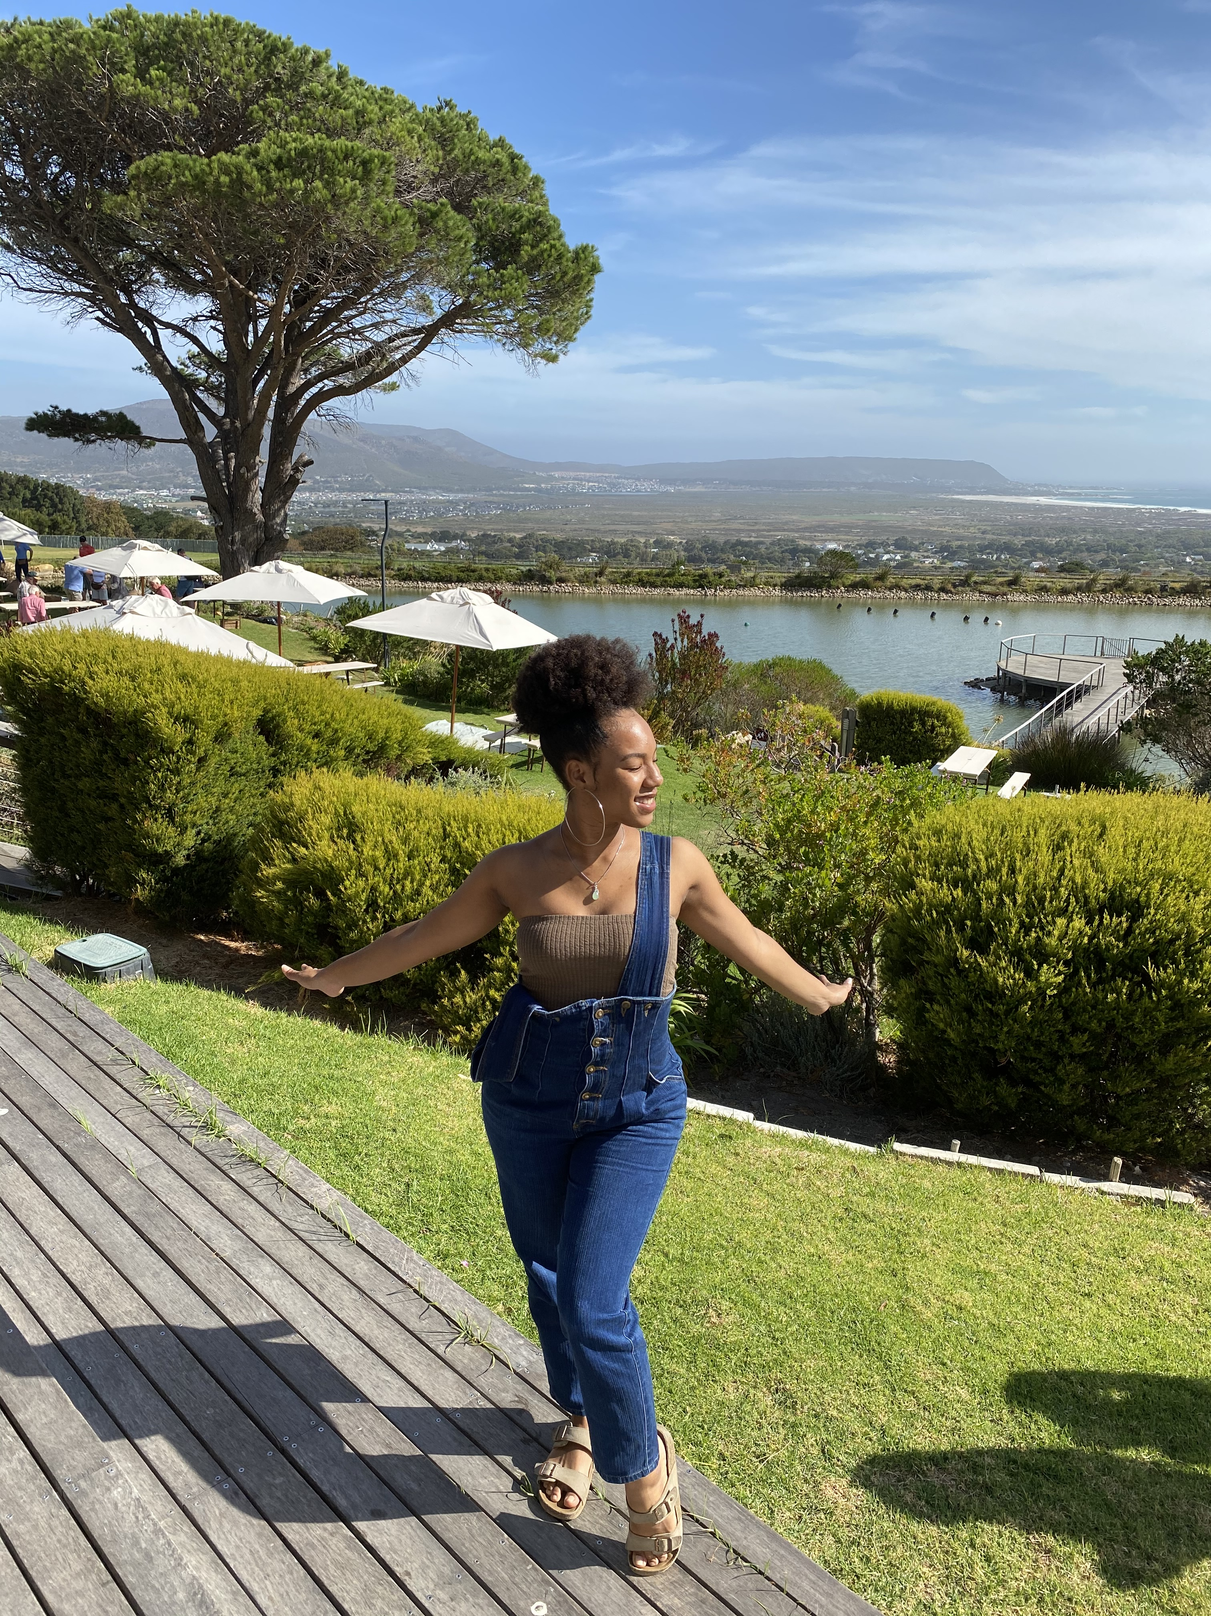
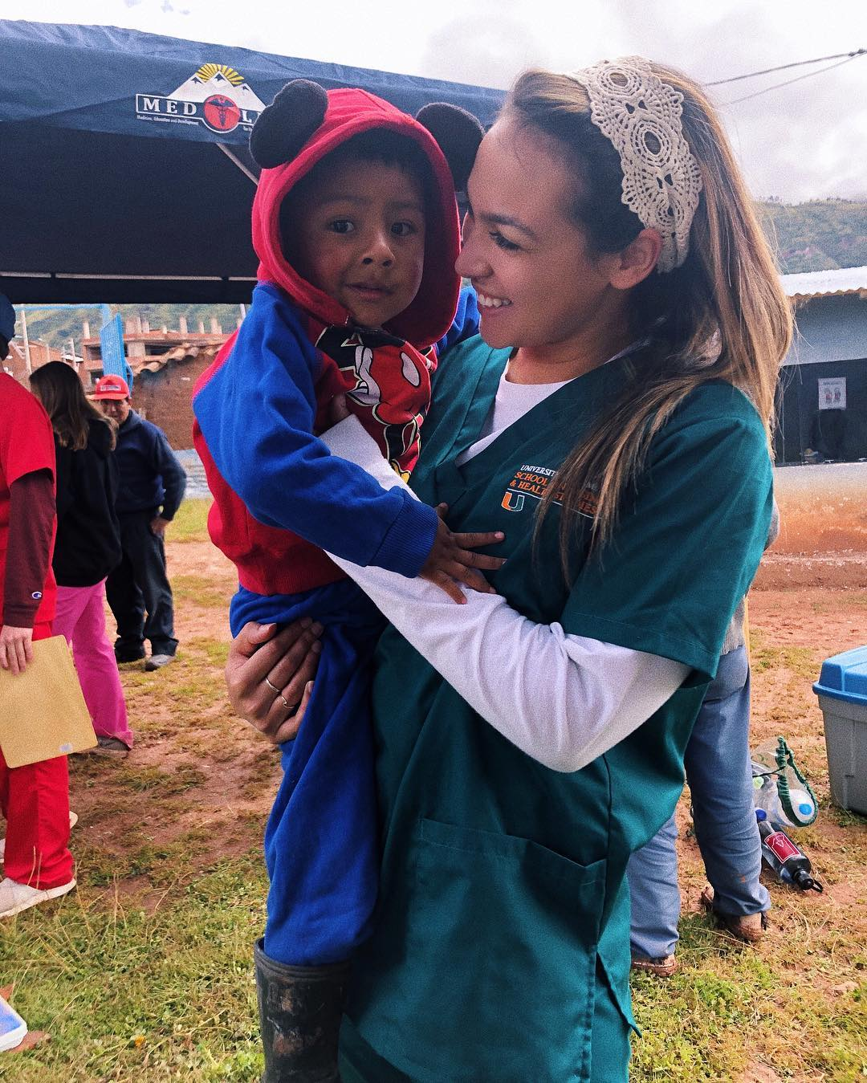
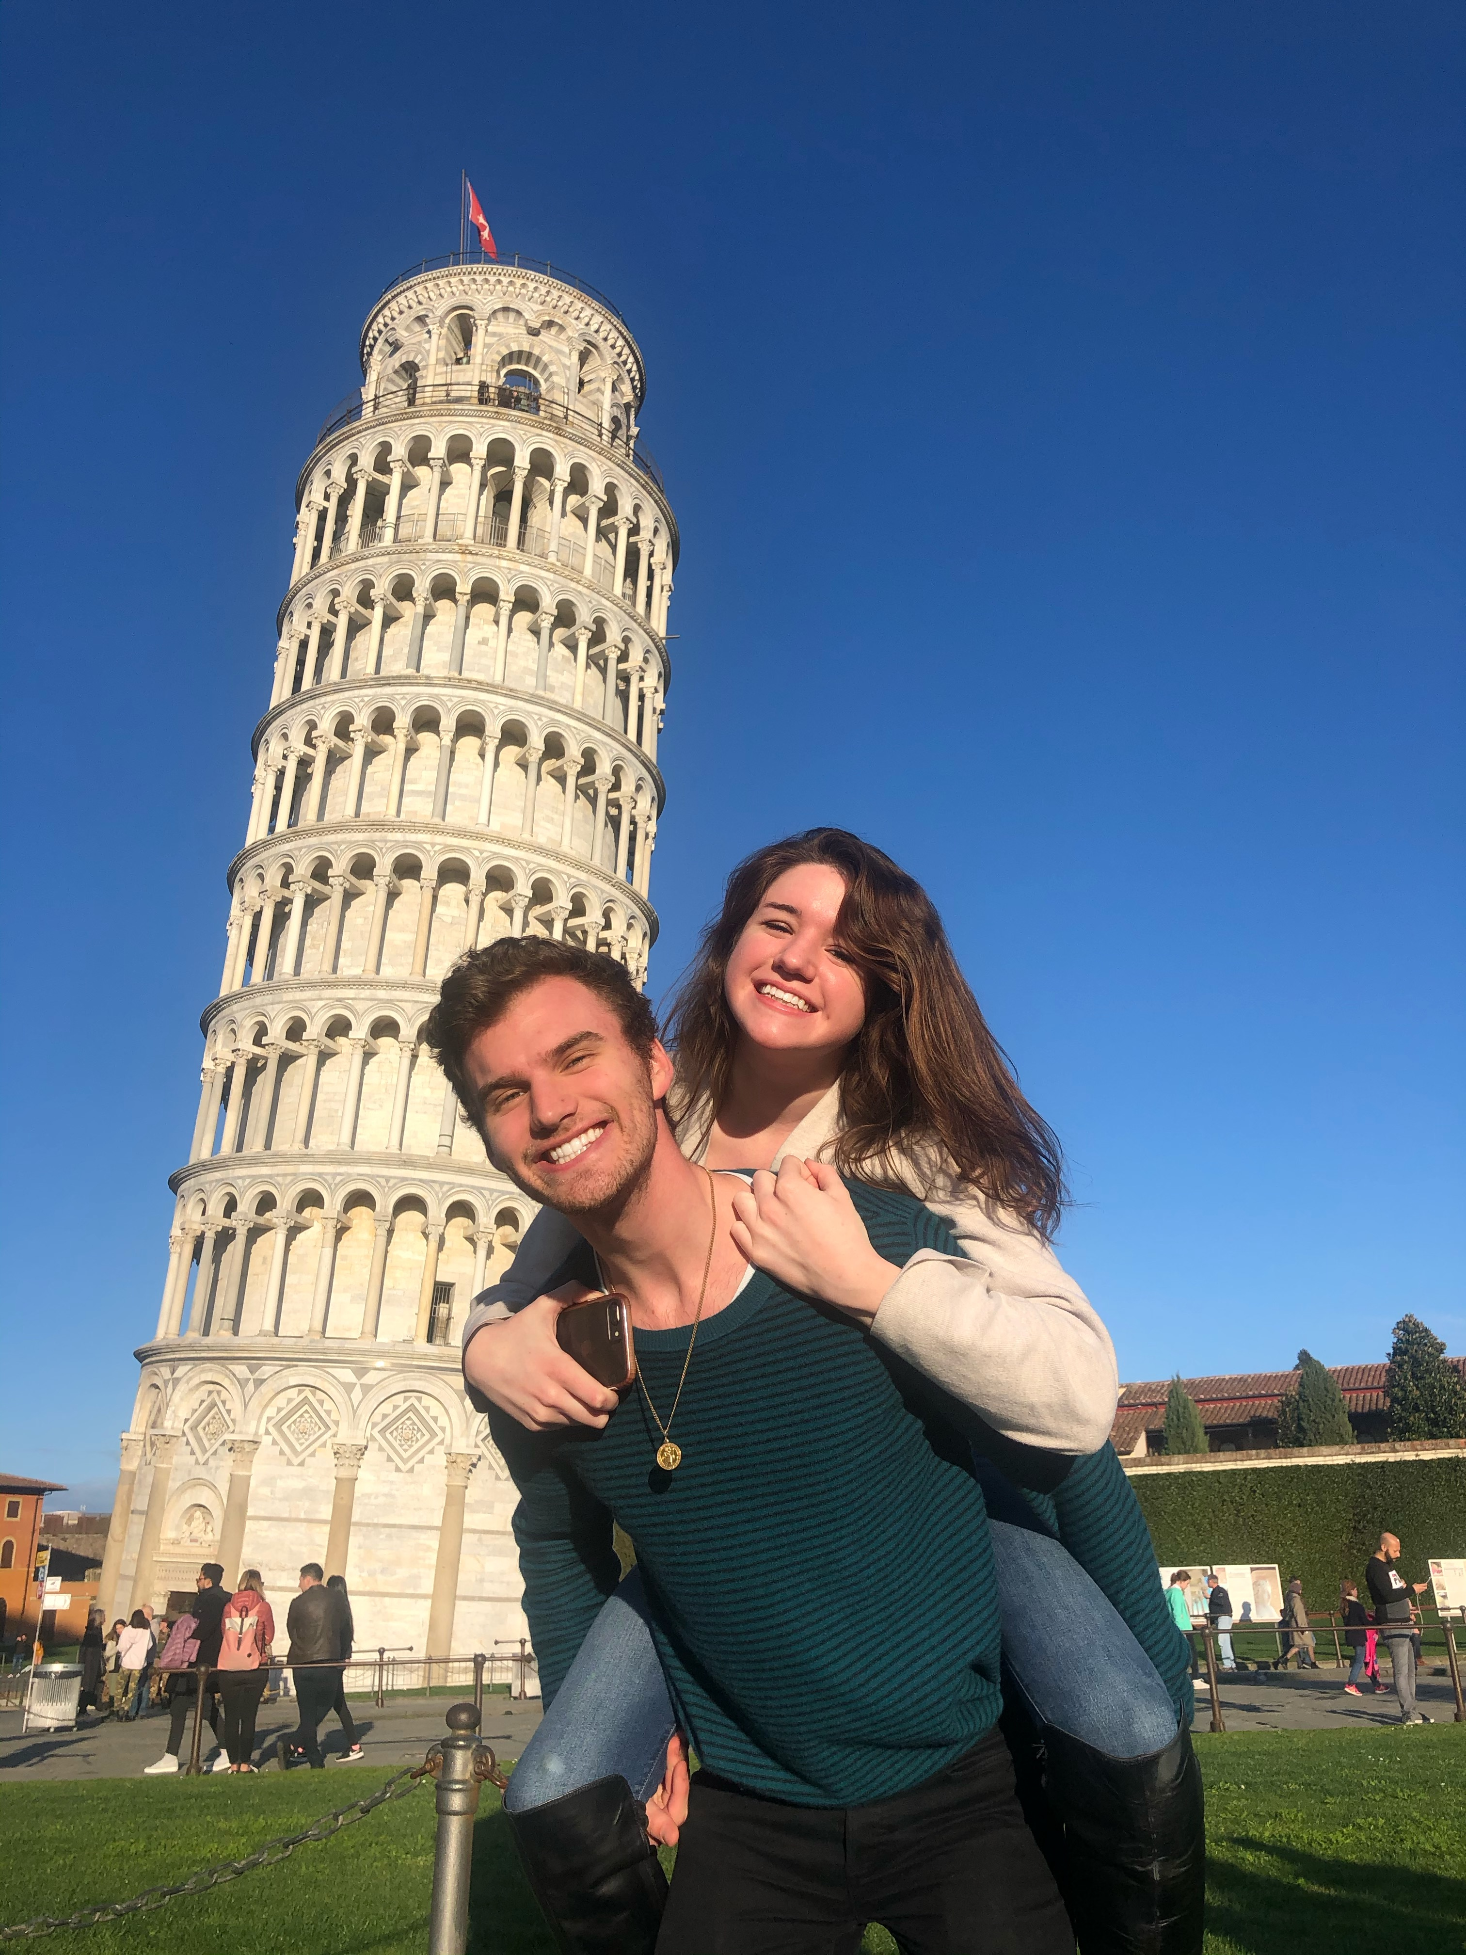
‘Canes around the World
Senior Chinoia Weir captures a great moment with her fellow Sigma Tau Delta members during their visit to St Louis for the international English honors society’s 2019 convention.
"Always keep that happy naivety, that charming ignorance"
-Jean Auguste Dominique Ingres (1912)
For if you do so, your growth and education will never cease!
Congratulations Class of 2020!!
- Kyle Trowbridge
Clockwise from top left: Nia Lennan while studying abroad in Cape Town, South Africa; Carolina Mallar studying abroad at Oxford University in 2018; Annie Boyle and Frederic Doub on a trip to Italy while studying abroad; Gemma St. Louis putting her Spanish major to good use on a MEDLIFE service-learning trip in Cusco, Perú
11
12

Slide 8
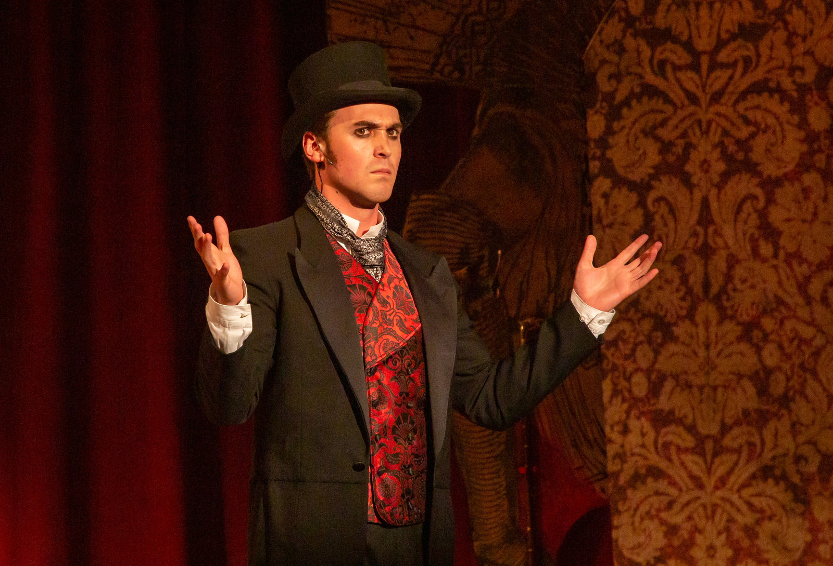
Dear Class of 2020,
Graduations are often a time of excitement and anxiety as you leave the world you have known to step into a world of new possibilities. The COVID-19 virus has made the world you are stepping out into so much different than you have anticipated it being four months ago. Be not afraid. COVID-19 is a powerful force, wreaking havoc around the world. Yet, because of it, we have learned that many things that we were told were impossible have proven to be doable. They are housed the homeless. For how long, I don’t know. But it has been done. They have provided healthcare, yes, only for this one disease, but it was done.
Remember when this has passed, what remains of the world is yours.
You can make impossible things happen.
You can, you must make a future.
And you will.
Congratulations on all you have done, and all you will do.
cfrancis blackchild
Noah Vesey (2020 Musical Theatre BFA) as John Jasper in UM's Fall 2019 production of The Mystery of Edwin Drood.
“Why do you want to shut out of your life any uneasiness, any misery, any depression, since after all you don't know what work these conditions are doing inside you? Why do you want to persecute yourself with the question of where all this is coming from and where it is going? Since you know, after all, that you are in the midst of transitions and you wished for nothing so much as to change. If there is anything unhealthy in your reactions, just bear in mind that sickness is the means by which an organism frees itself from what is alien; so one must simply help it to be sick, to have its whole sickness and to break out with it, since that is the way it gets better.”
― Letters to a Young Poet, by Rainer Maria Rilke
13
14

Slide 9
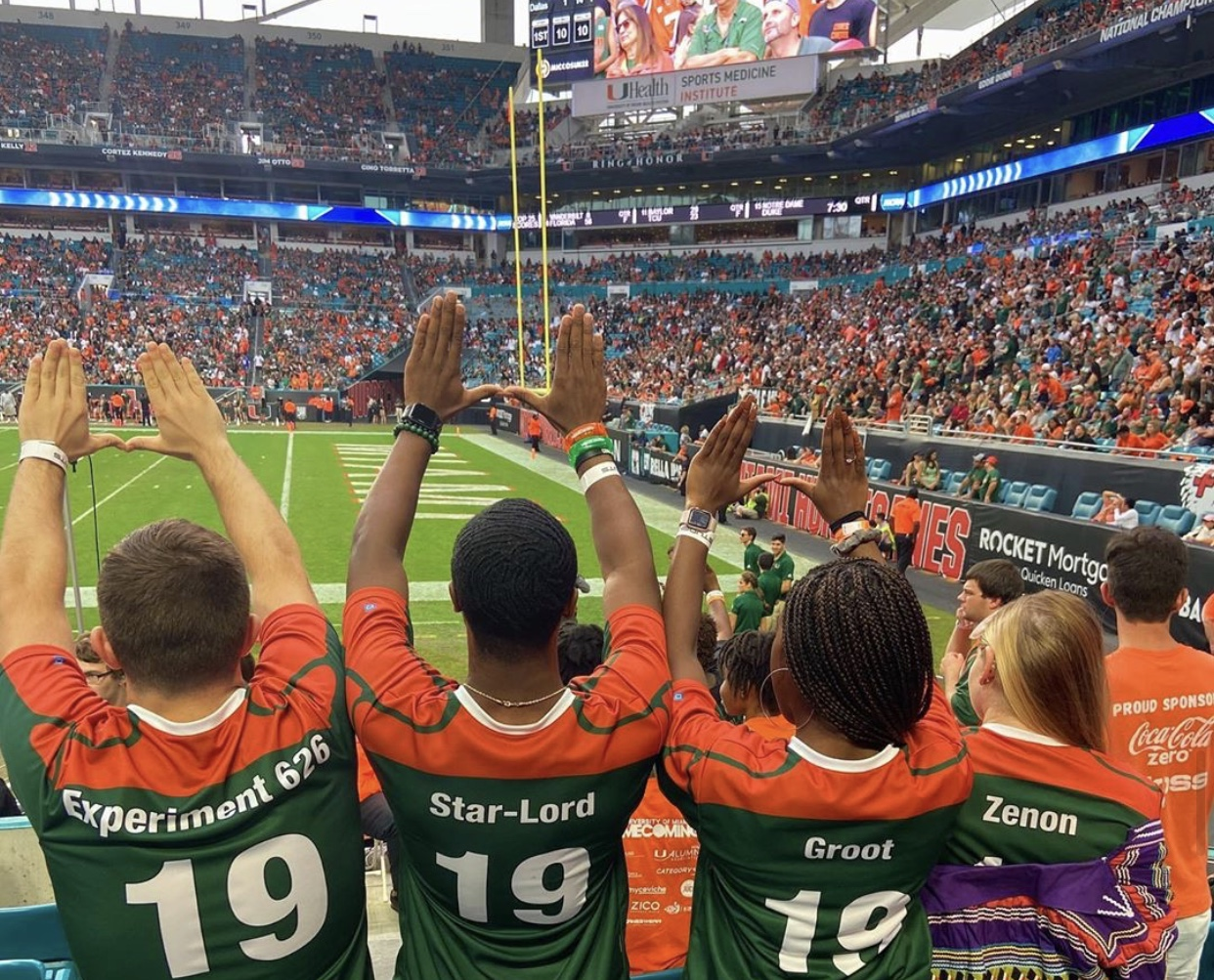
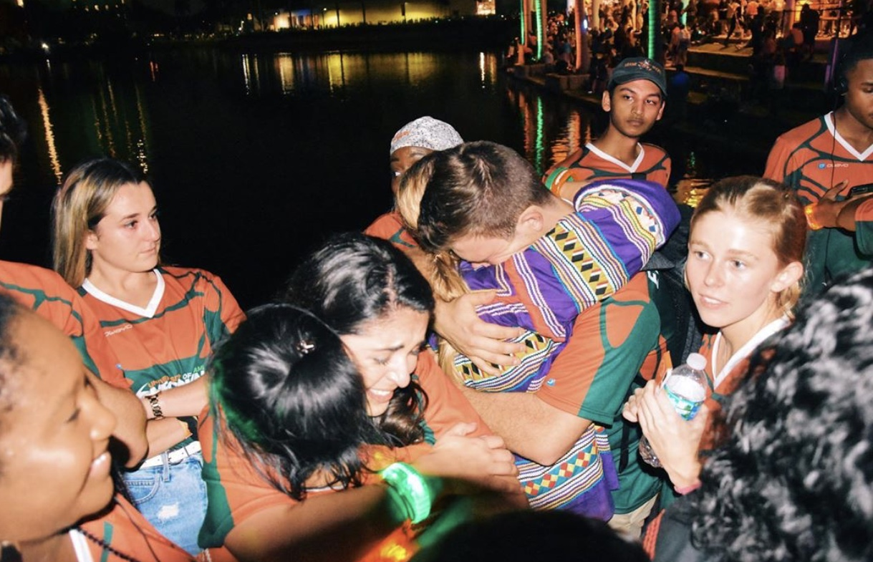
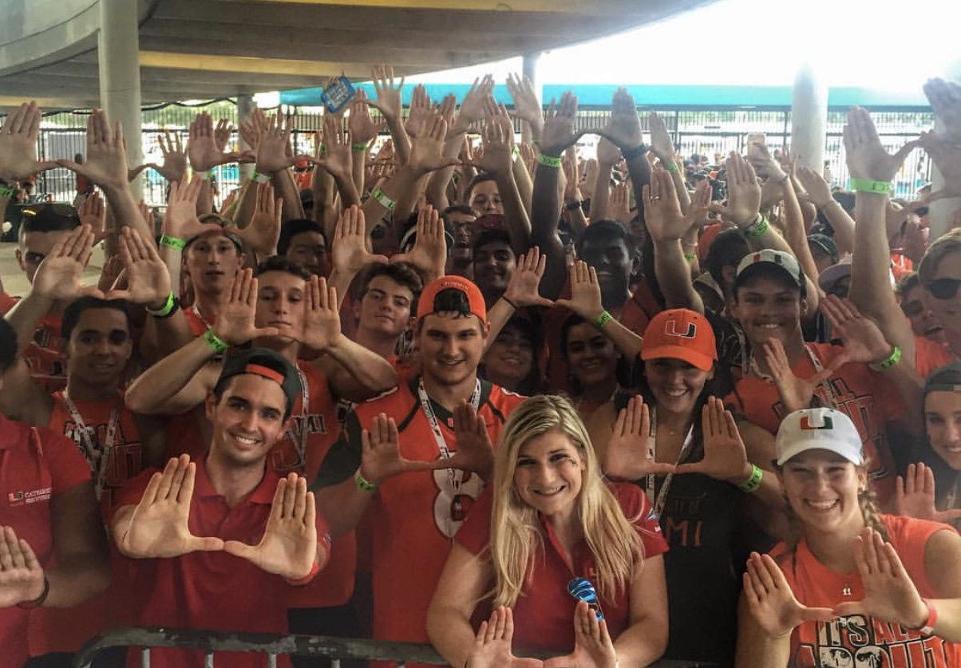
Homecoming
From Dr. Claire Oueslati-Porter:
"The art of life is not controlling what happens to us, but using what happens to us."
- Gloria Steinem, Revolution from Within: A Book of Self-Esteem
15
16

Slide 10
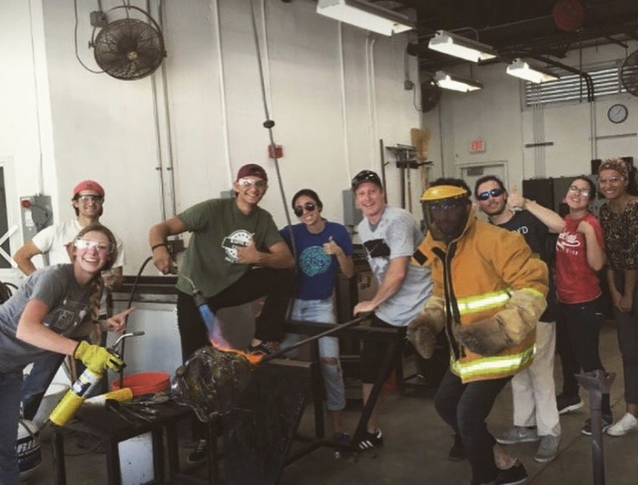
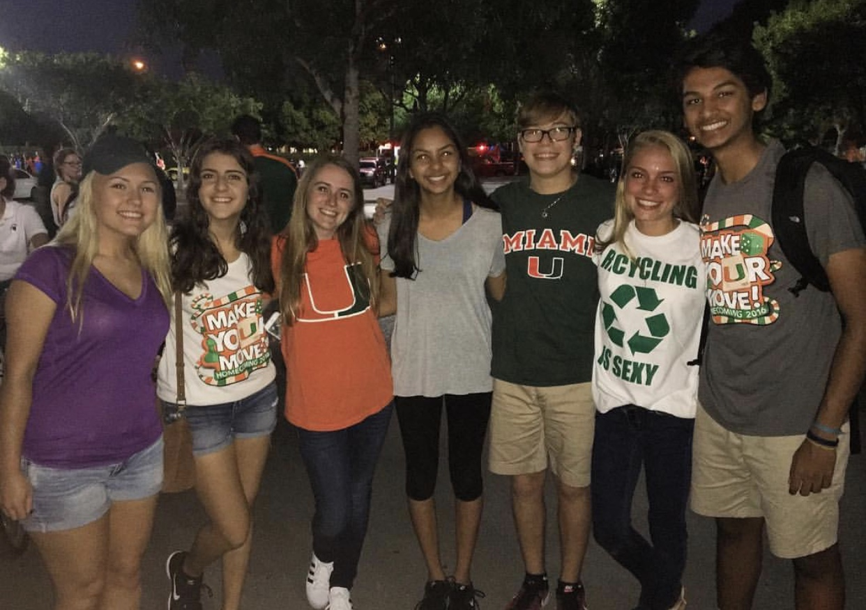
Dear UM Class of 2020,
As you wander into your future, I offer you a beautiful short poem written one-hundred-and-twenty years ago -- WB Yeats’ magical “The Song of Wandering Aengus.”
As Shirley Hazzard once wrote: “the greatest literary influence lies in arousing us to words, to expressive speech. That comes through reading, through the pleasure and excitement of reading.”
Best Wishes,
Professor Catherine Nealy Judd
The Song of Wandering Aengus
BY WILLIAM BUTLER YEATS
I went out to the hazel wood,
Because a fire was in my head,
And cut and peeled a hazel wand,
And hooked a berry to a thread;
And when white moths were on the wing,
And moth-like stars were flickering out,
I dropped the berry in a stream
And caught a little silver trout.
When I had laid it on the floor
I went to blow the fire a-flame,
But something rustled on the floor,
And someone called me by my name:
It had become a glimmering girl
With apple blossom in her hair
Who called me by my name and ran
And faded through the brightening air.
Though I am old with wandering
Through hollow lands and hilly lands,
I will find out where she has gone,
And kiss her lips and take her hands;
And walk among long dappled grass,
And pluck till time and times are done,
The silver apples of the moon,
The golden apples of the sun.
Glassblowing class with Jenna Efrein
“Now I think it’s one of the most useless questions an adult can ask a child—What do you want to be when you grow up? As if growing up is finite. As if at some point you become something and that’s the end.”
-Becoming by Michelle Obama
17
18

Slide 11
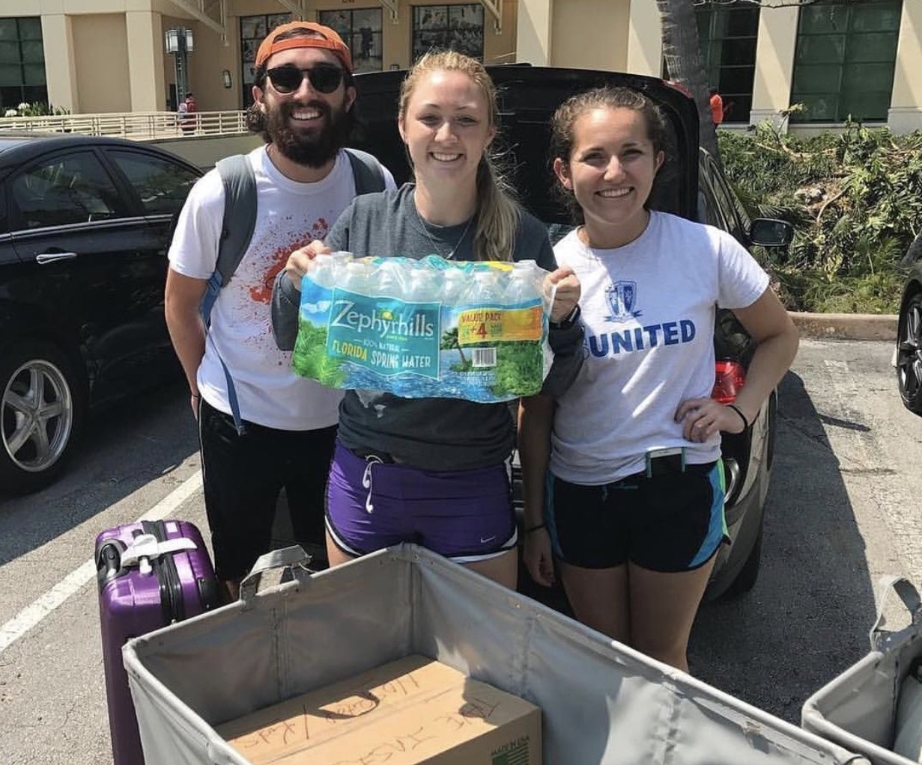
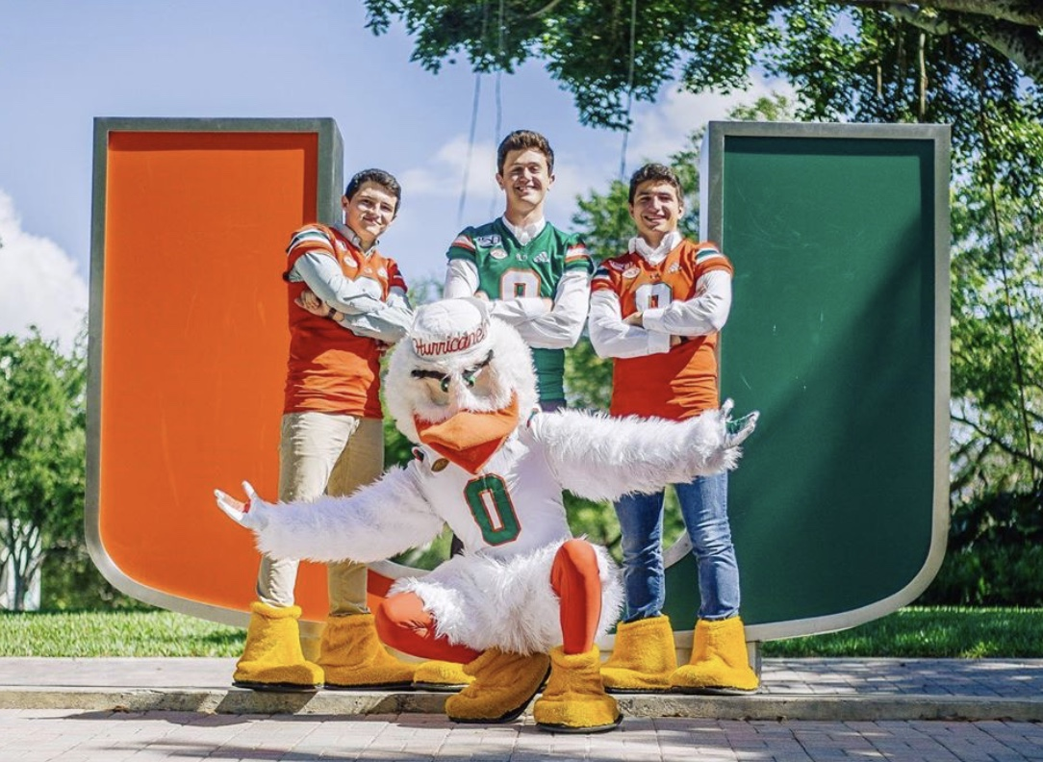
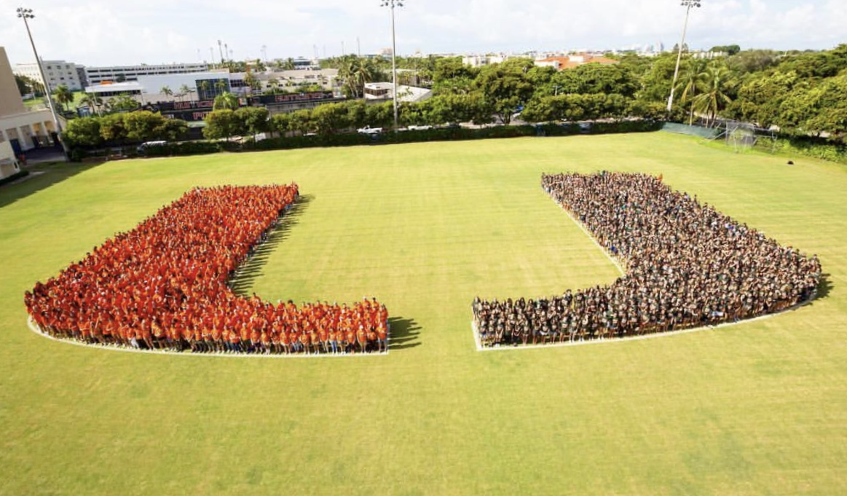
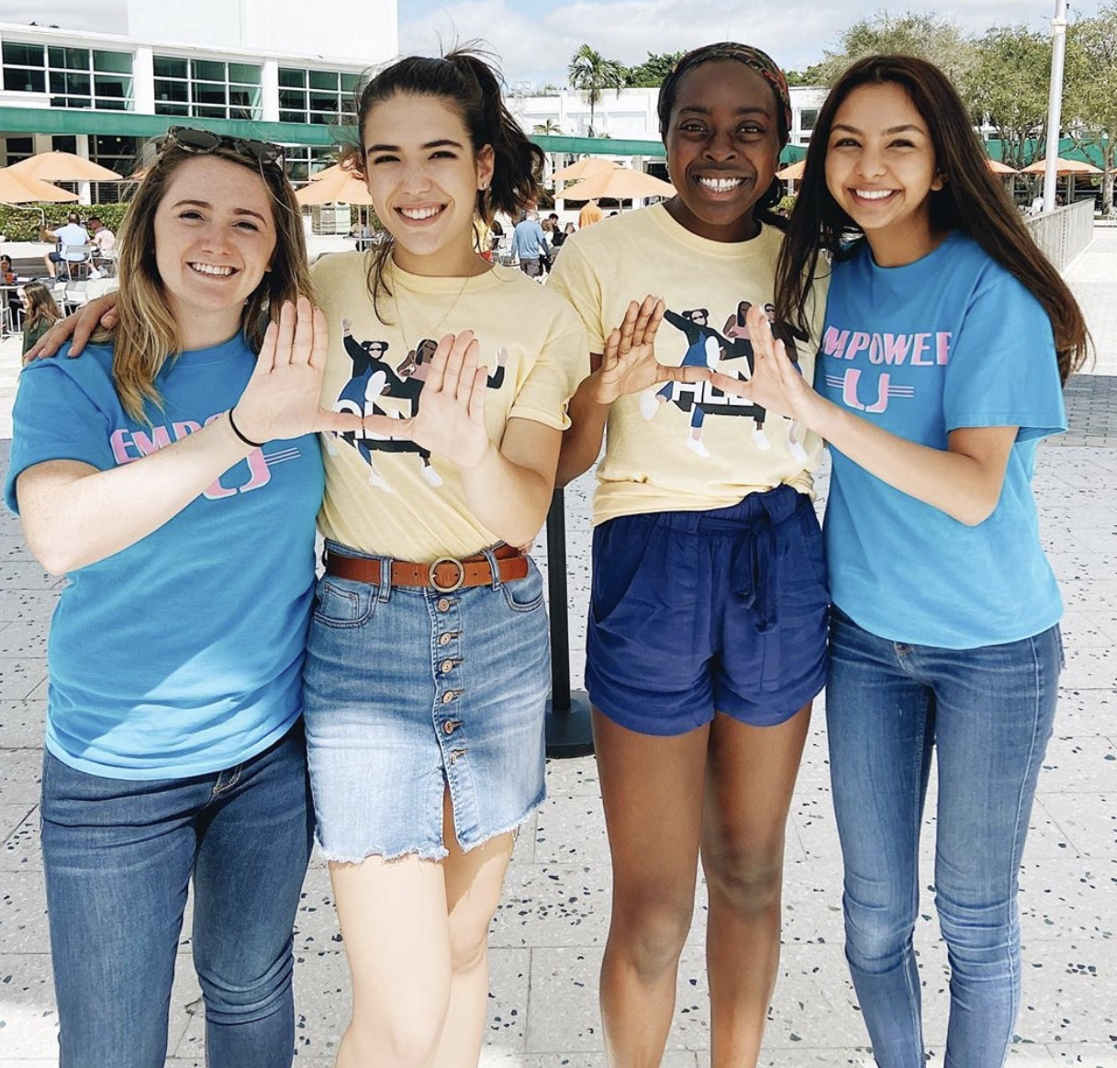
From
Freshman Orientation…
…To
Senior
Year
19
20

Slide 12
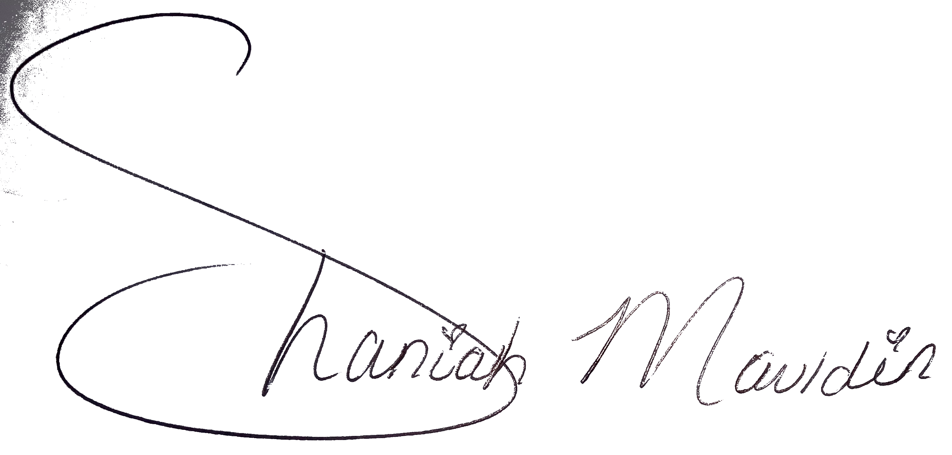
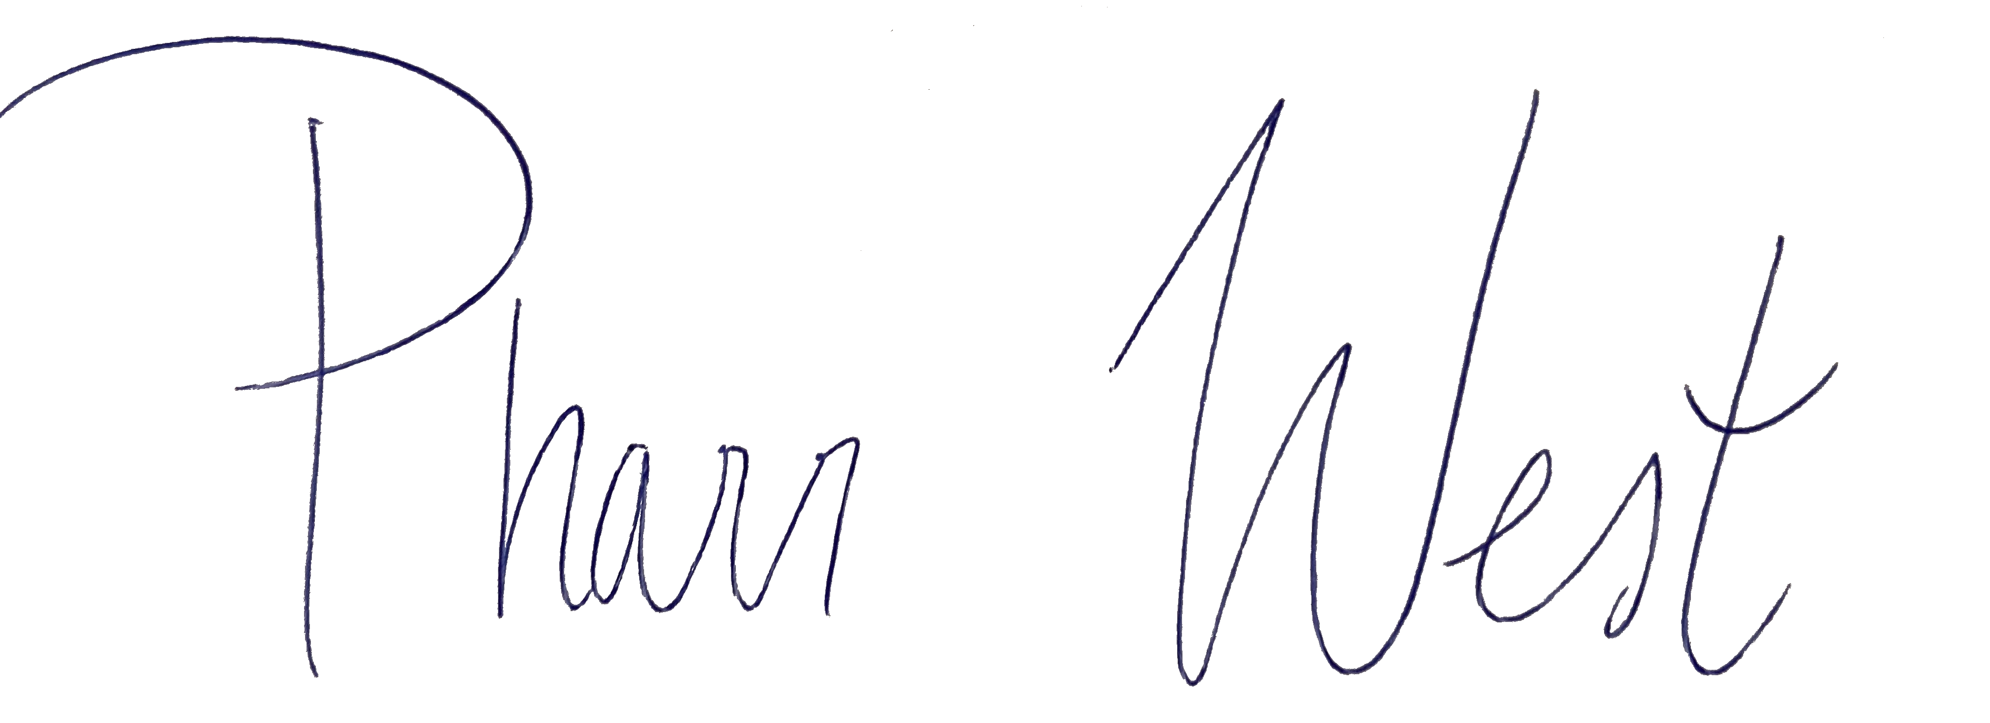
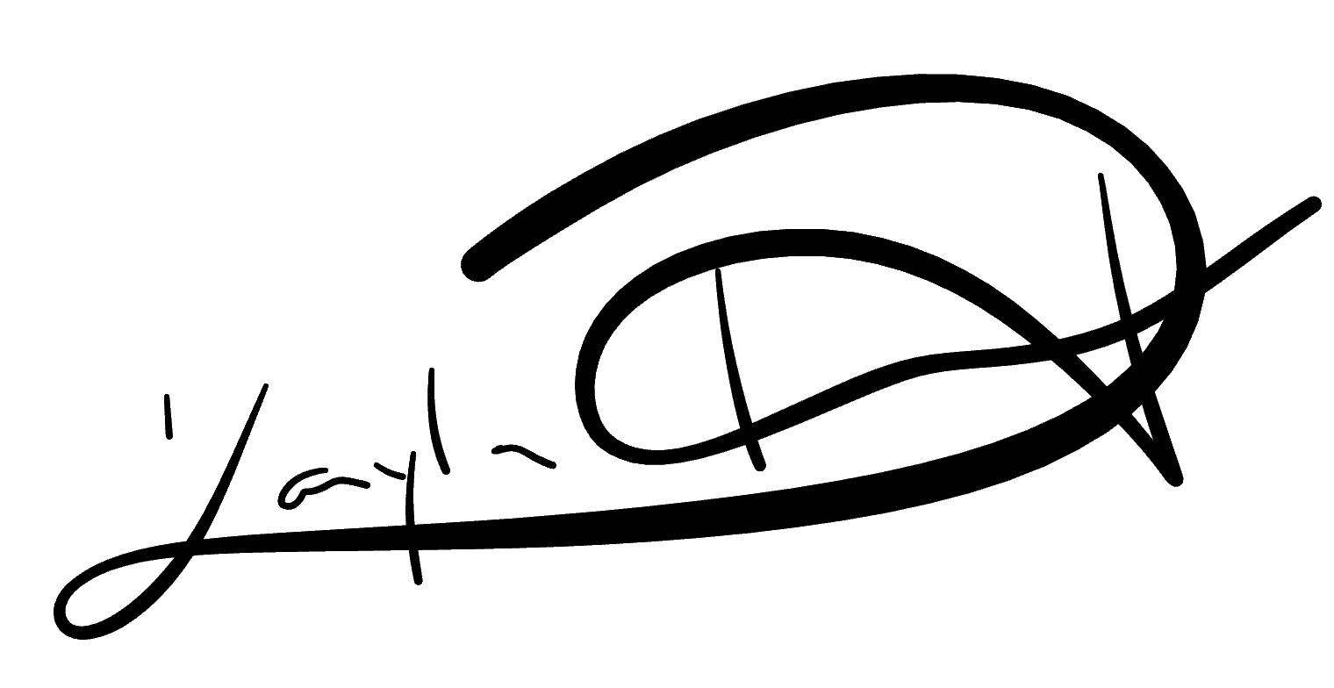
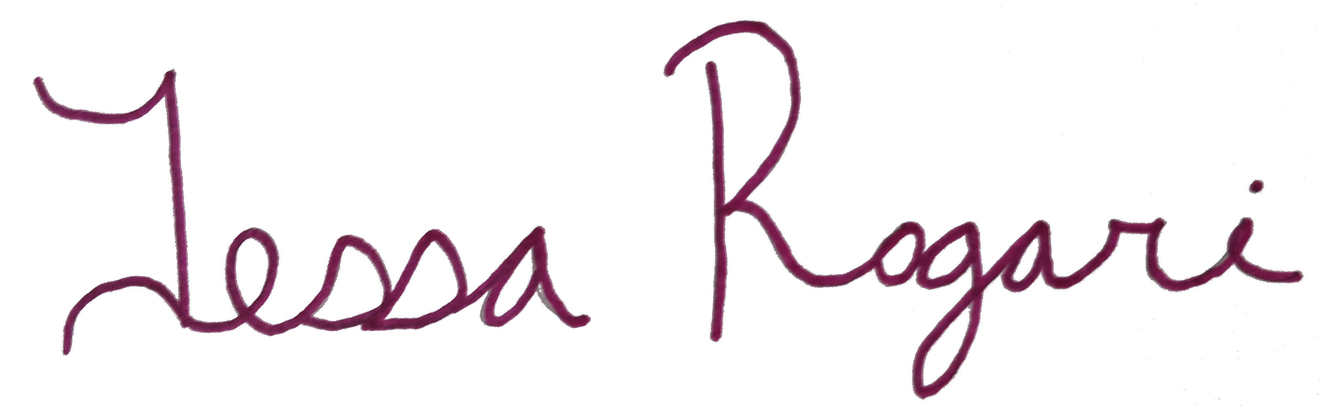
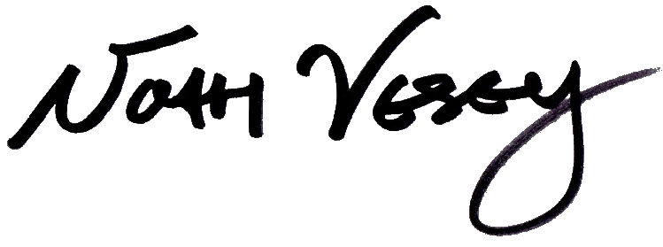
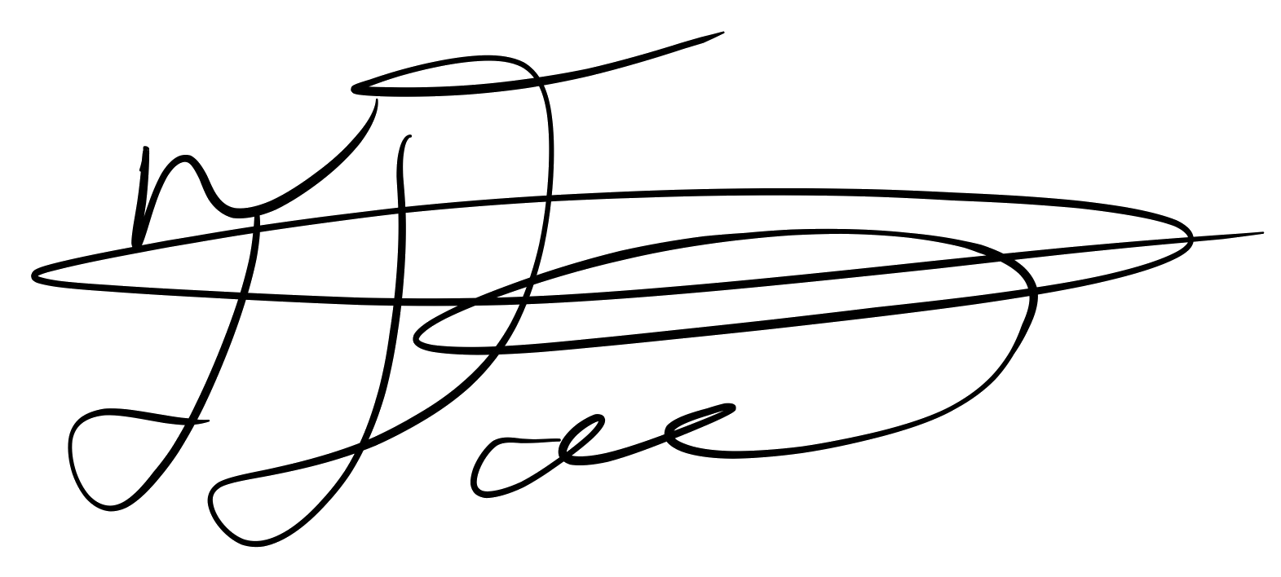
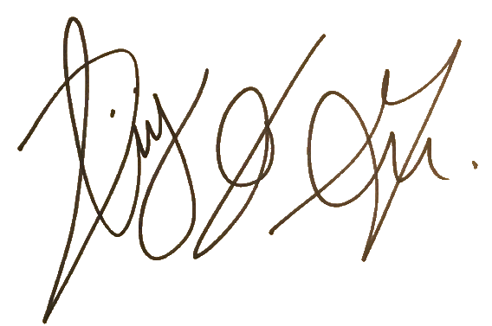
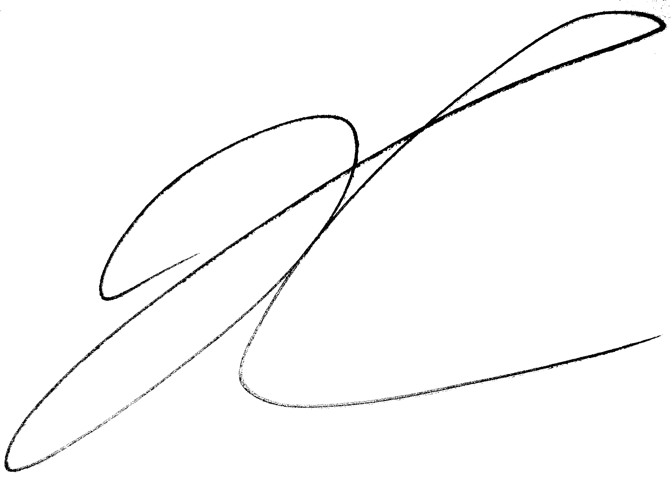
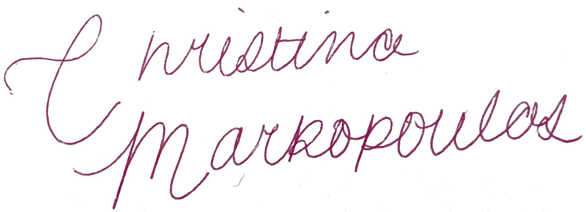
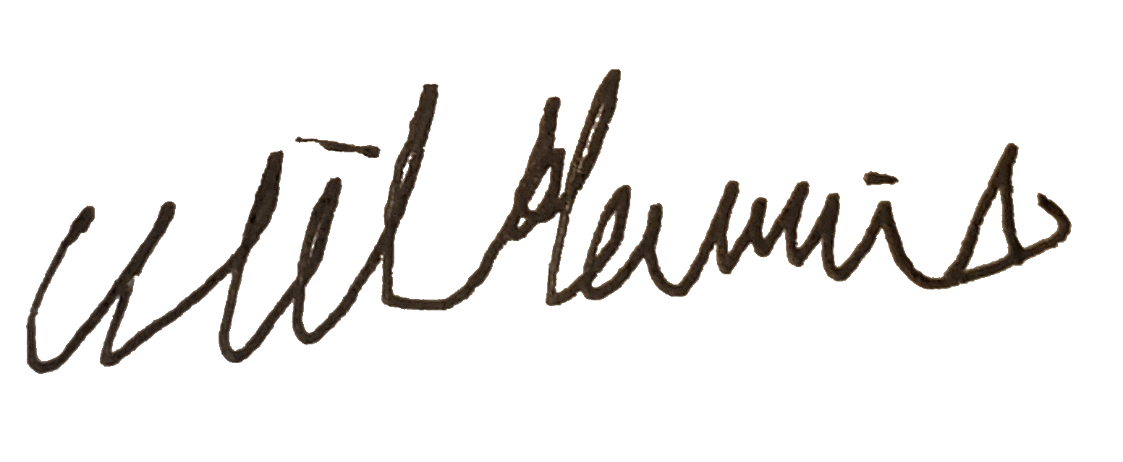
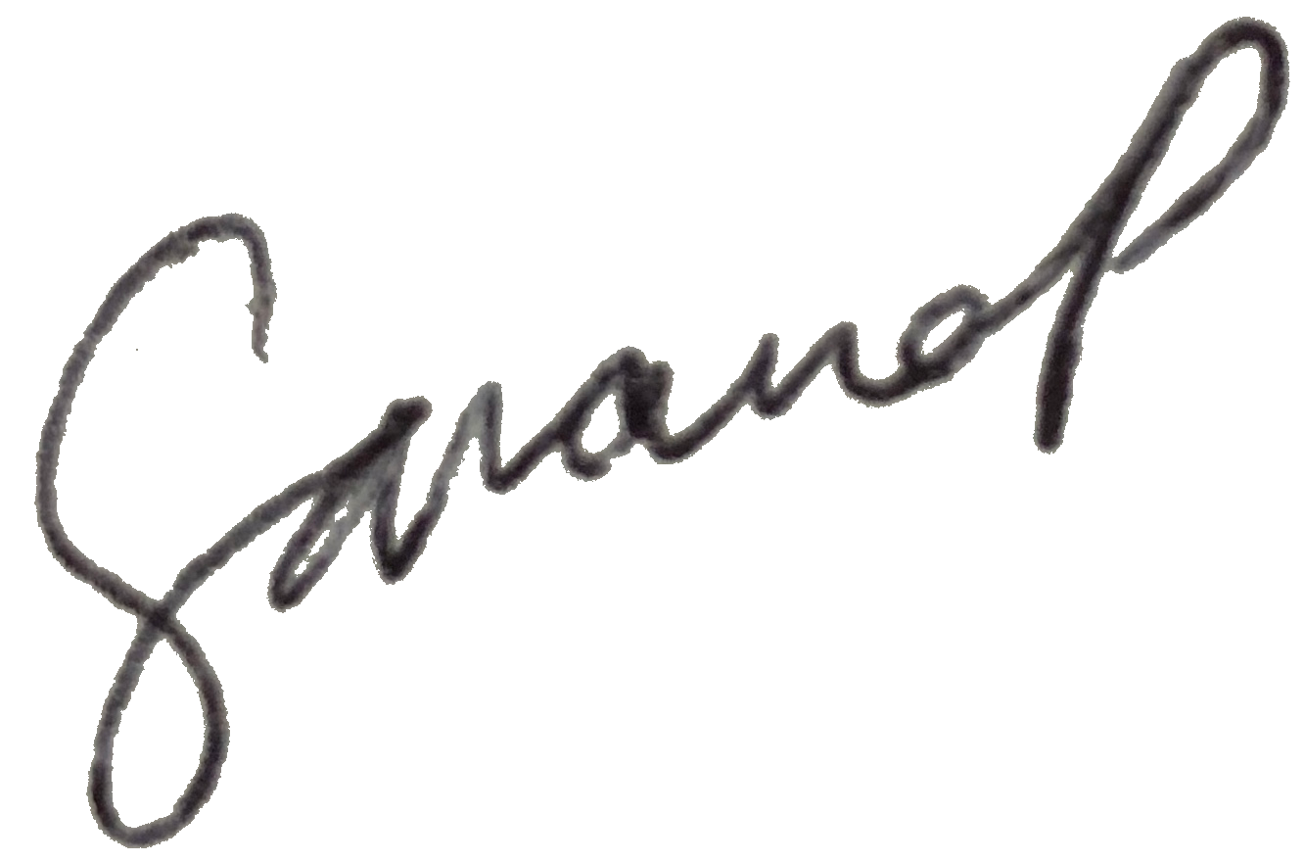
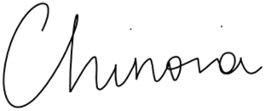
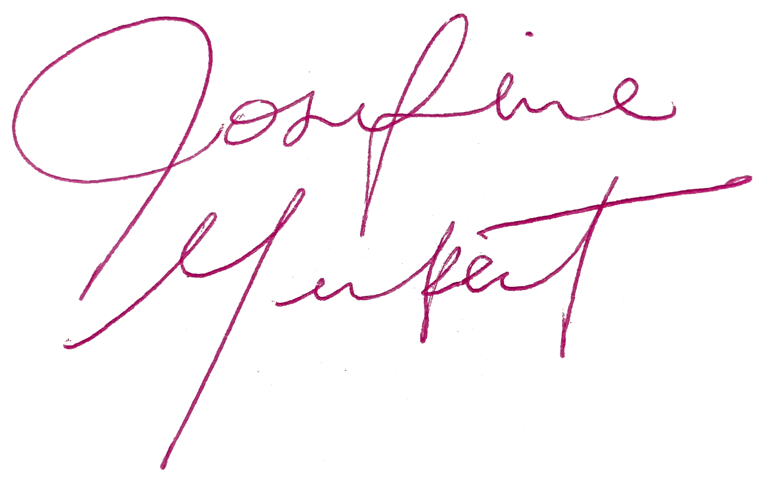
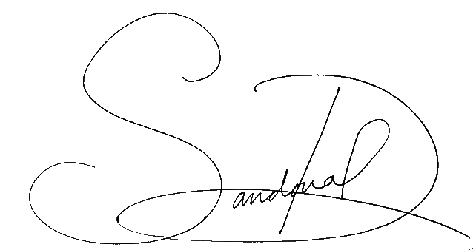
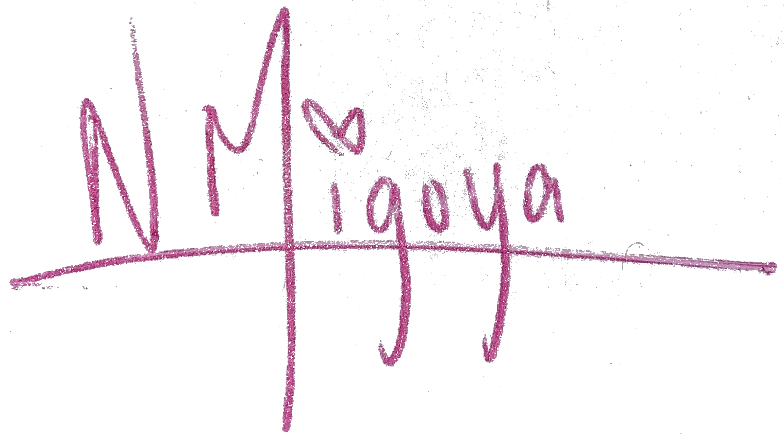
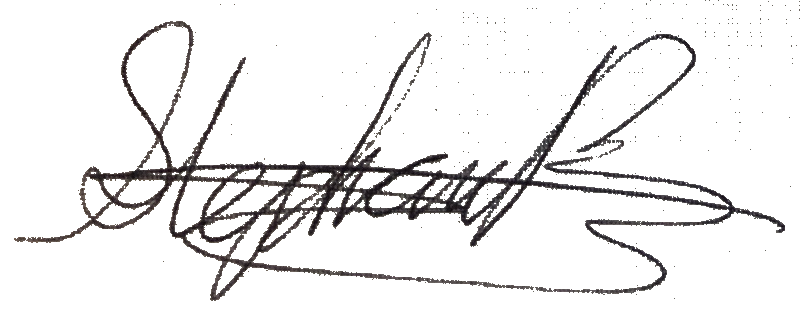
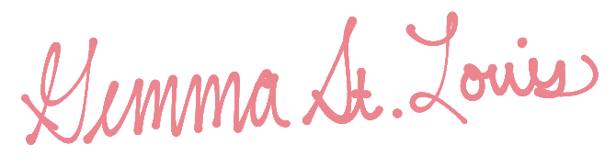
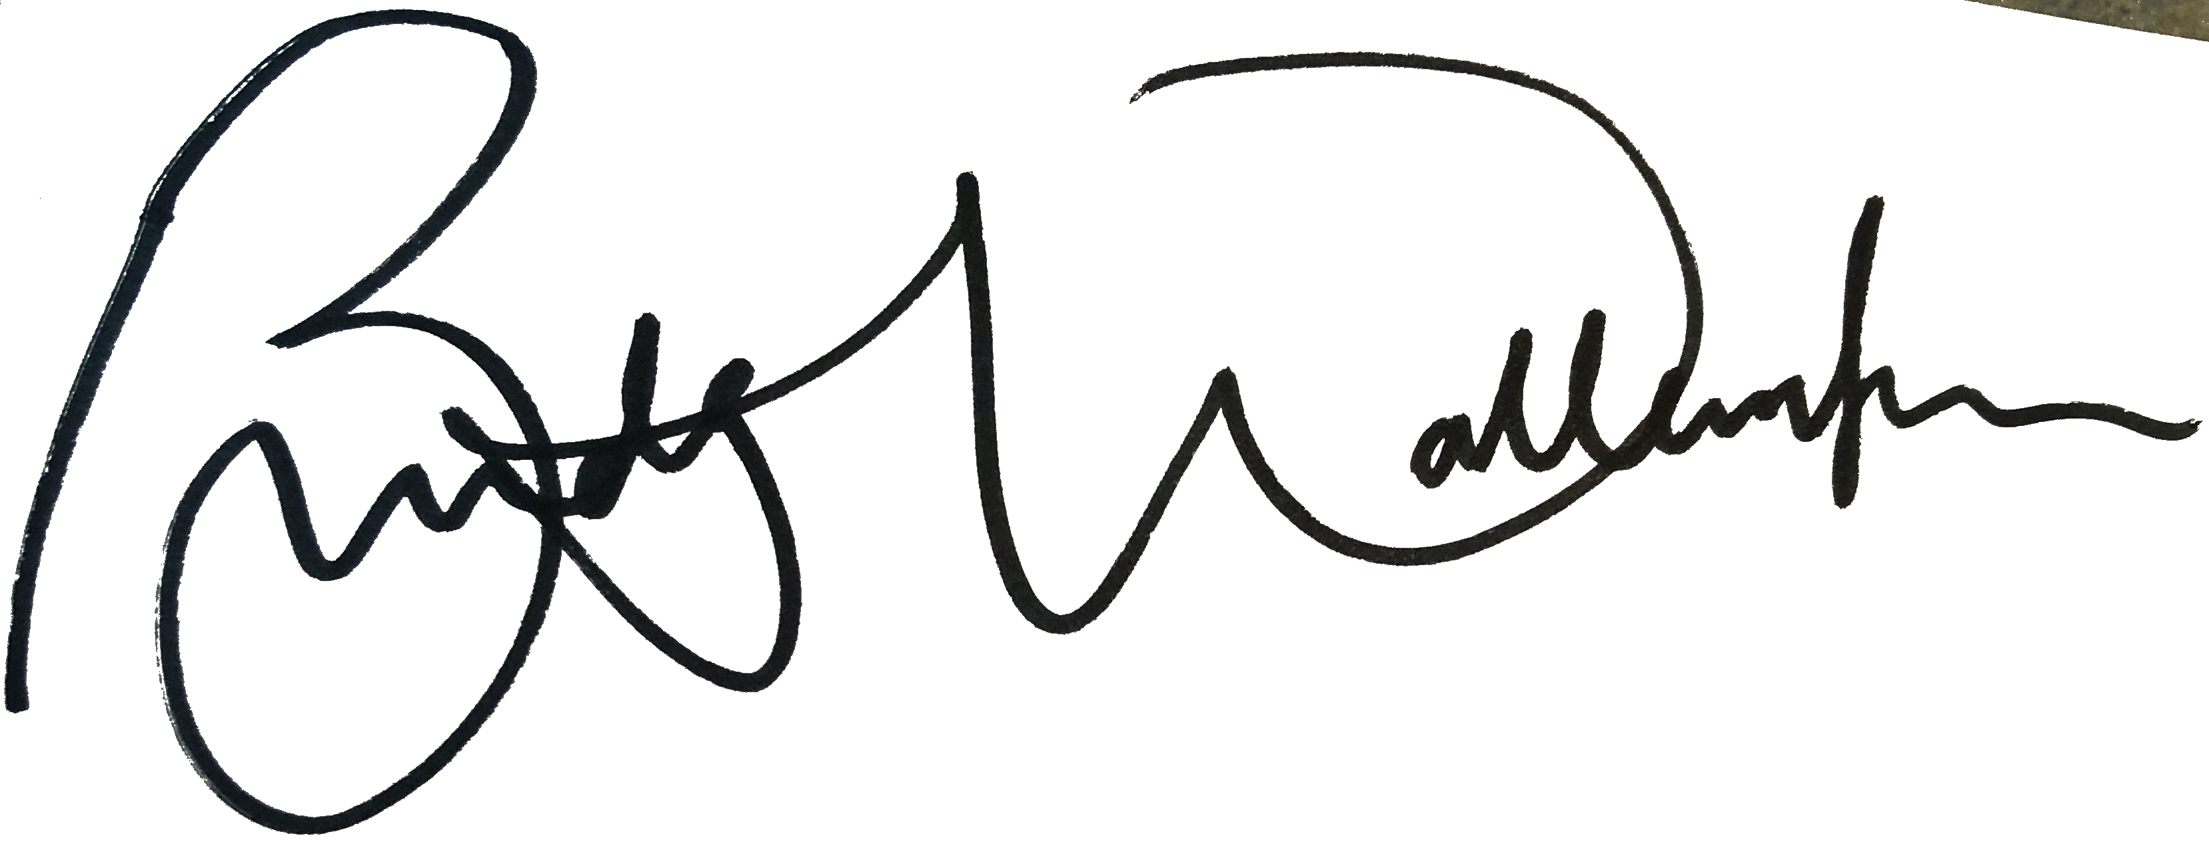
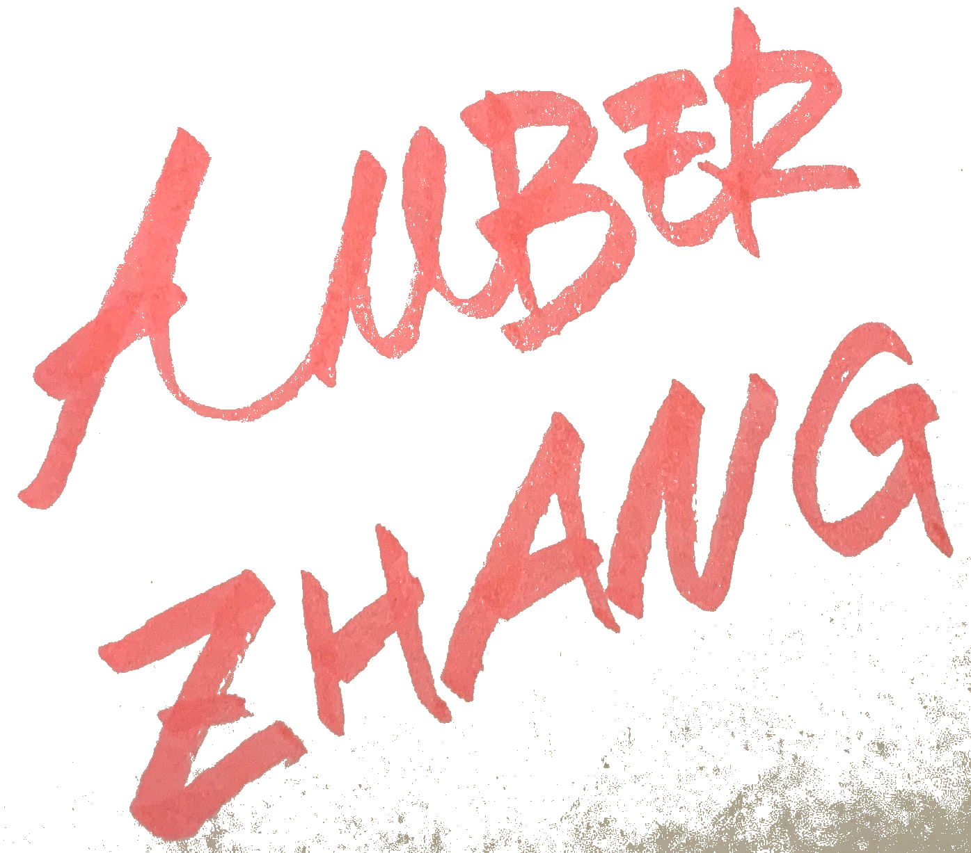
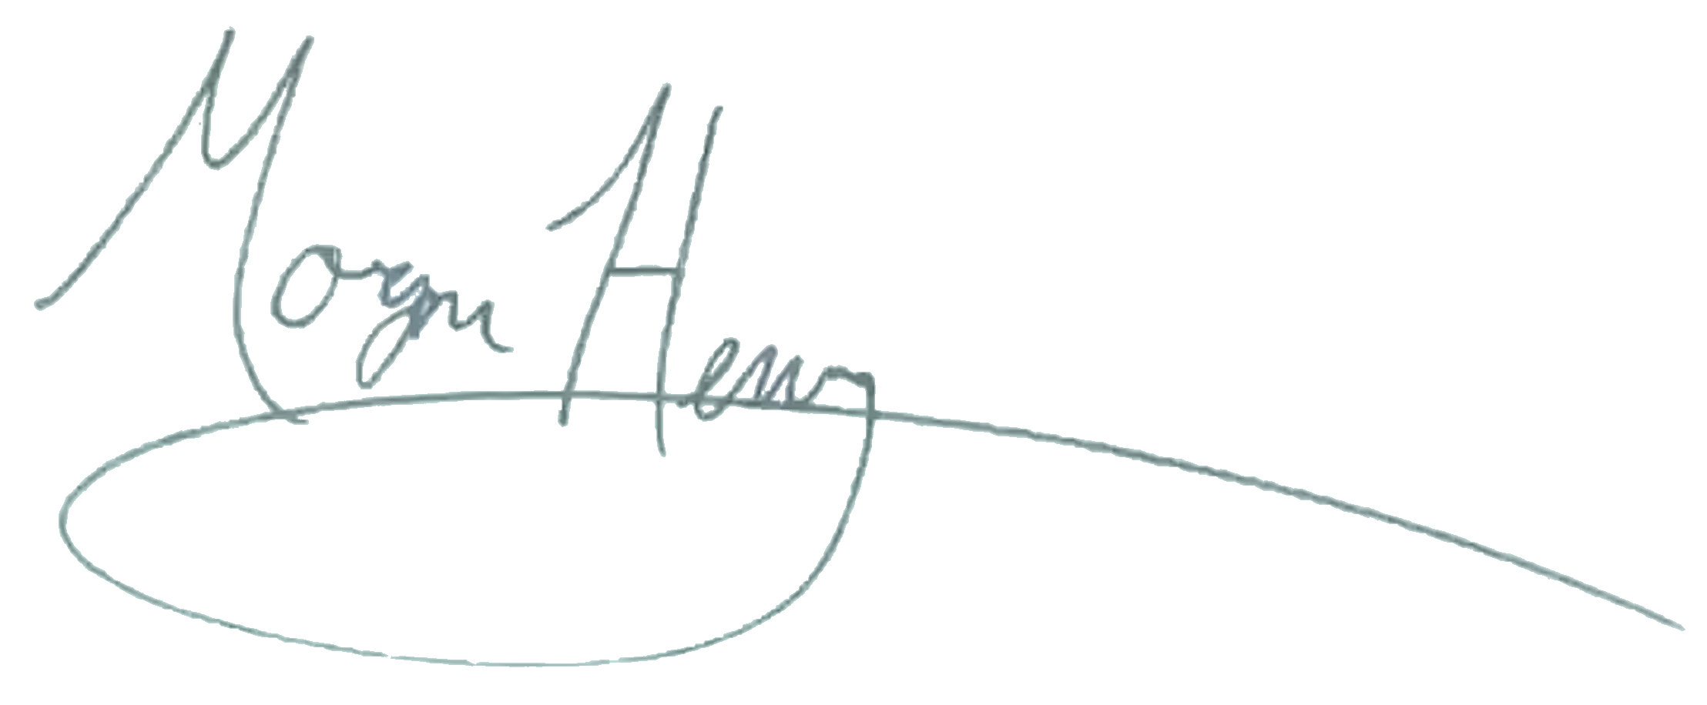
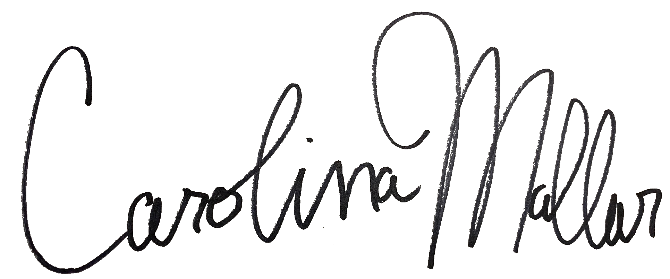
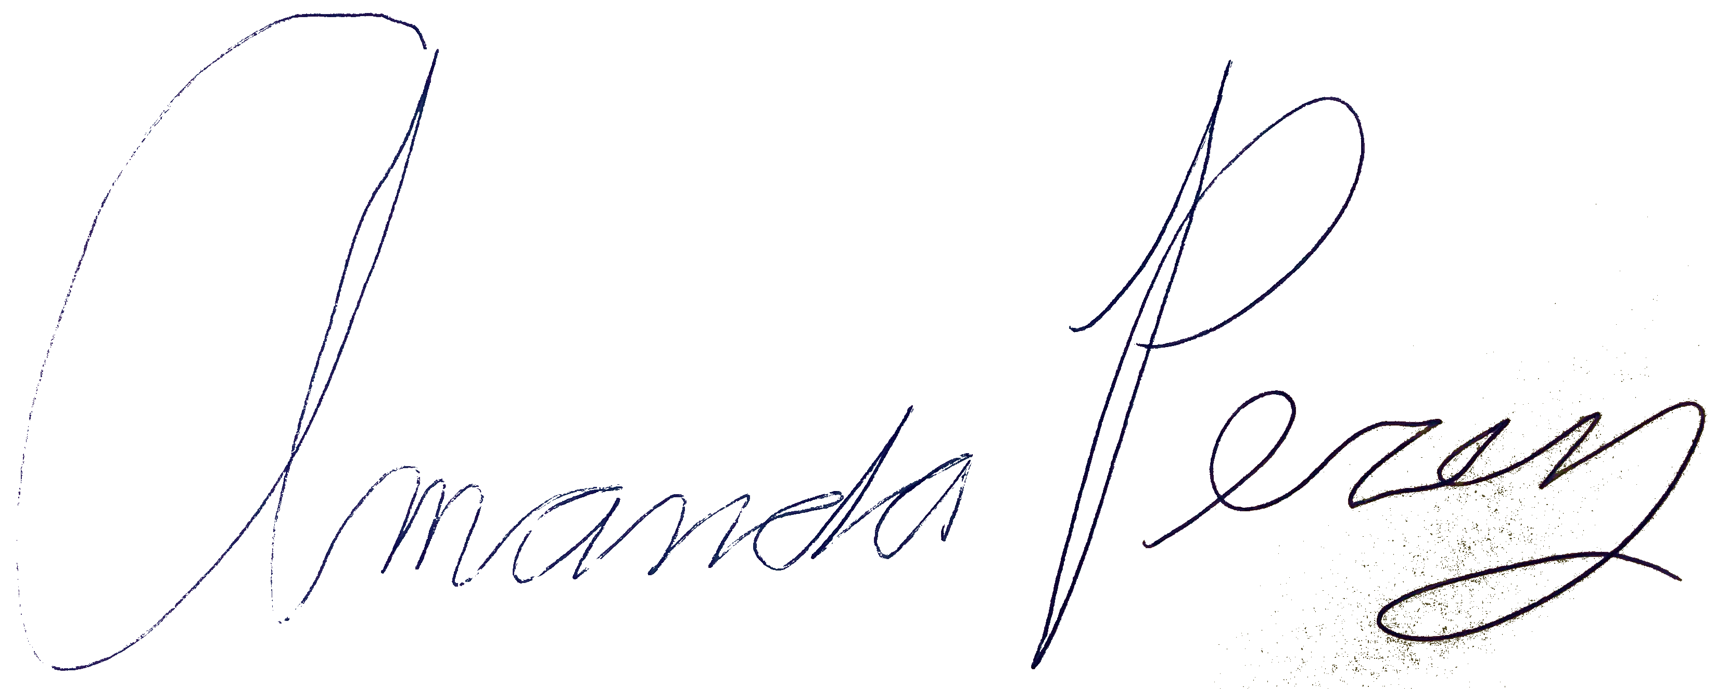
Signatures

Slide 13
1
2

